Slide 1


Slide 2


Presentation Overview
Context
Introduction to dataset
Questions we’re looking to answer
Intensity of crime by division
Violent crime
Rate of crimes
Response time of Dallas Police Department
Victim demographics
Conclusion/Recommendations

Slide 3
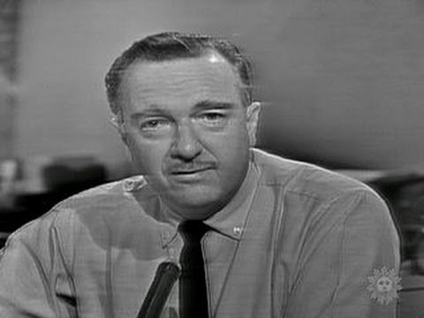

56 Years Ago...
CBS News Broadcast: November 22, 1963

Slide 4
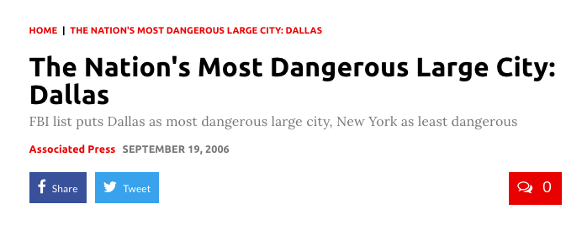
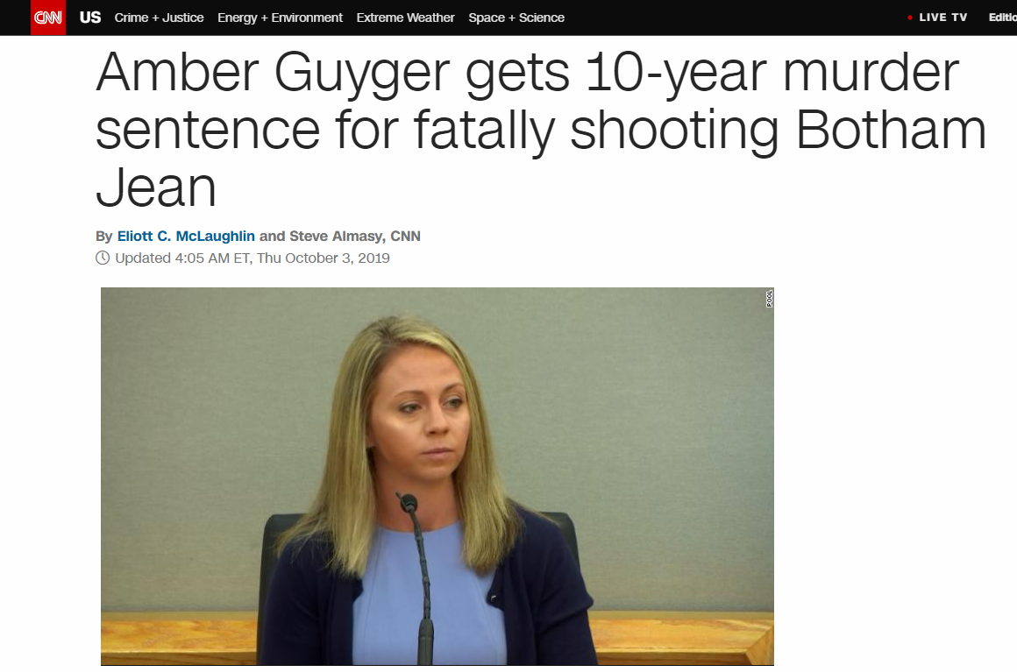
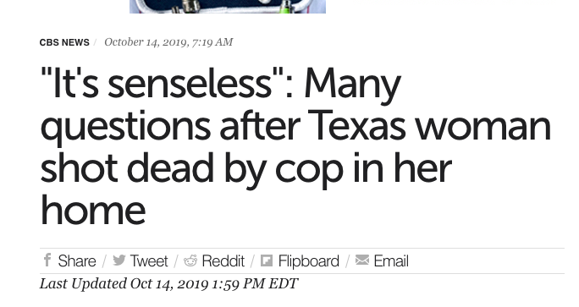
Dallas is STILL Dangerous, Y’all

Slide 5


Data
Dataset downloaded from City of Dallas website
Contains Incidents beginning June 1, 2014 to current-date
Started with 100 columns and 600,000 rows of data
Filtered the dataset to 2018 incidents alone, and after the clean up and were left with ~34 columns and 54,340 rows

Slide 6
Questions
Where is crime concentrated in Dallas?
What are the response rates of the Dallas Police Department?
Which is the most vulnerable section of Dallas society?

Slide 7
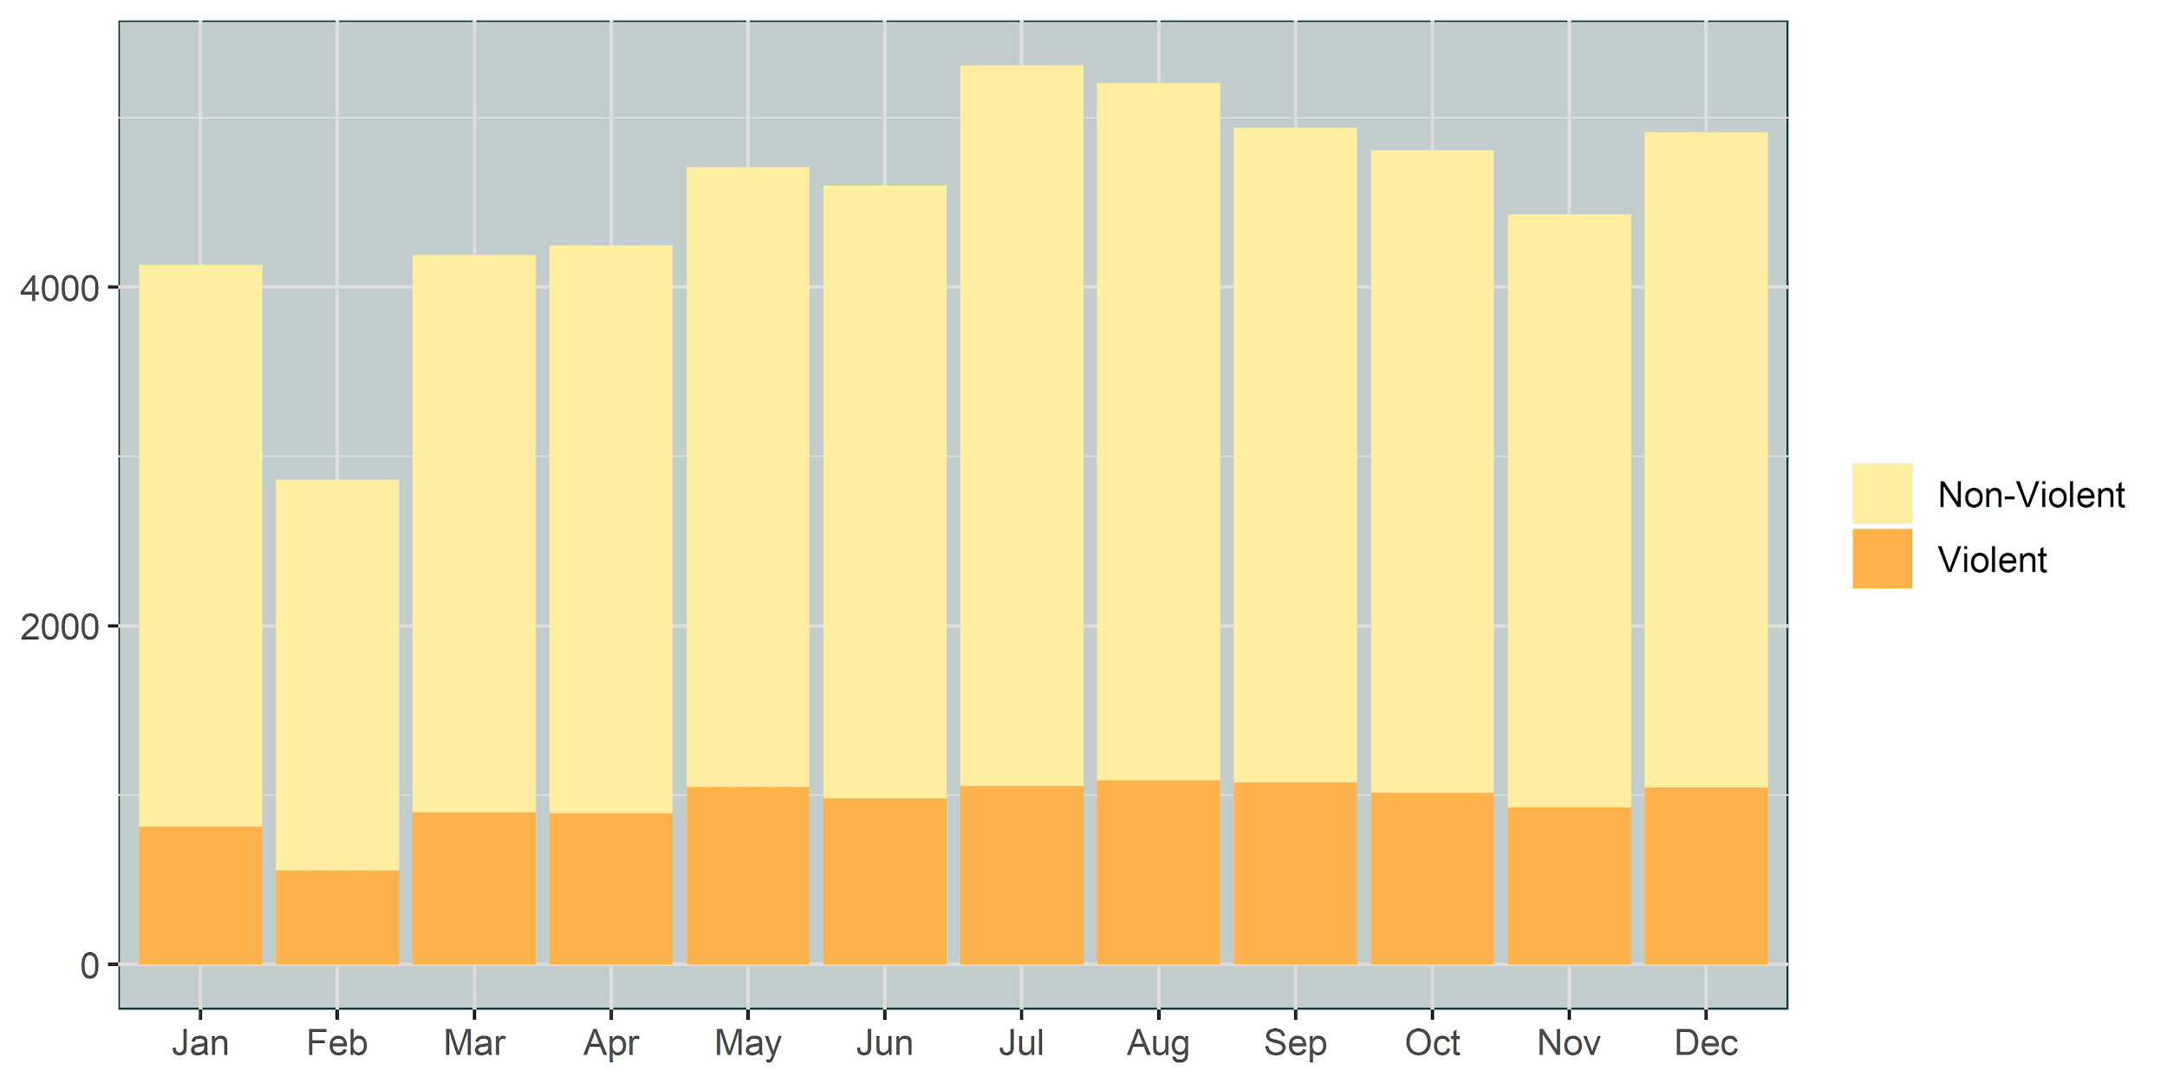
Total Police Incidents by Month

Slide 8
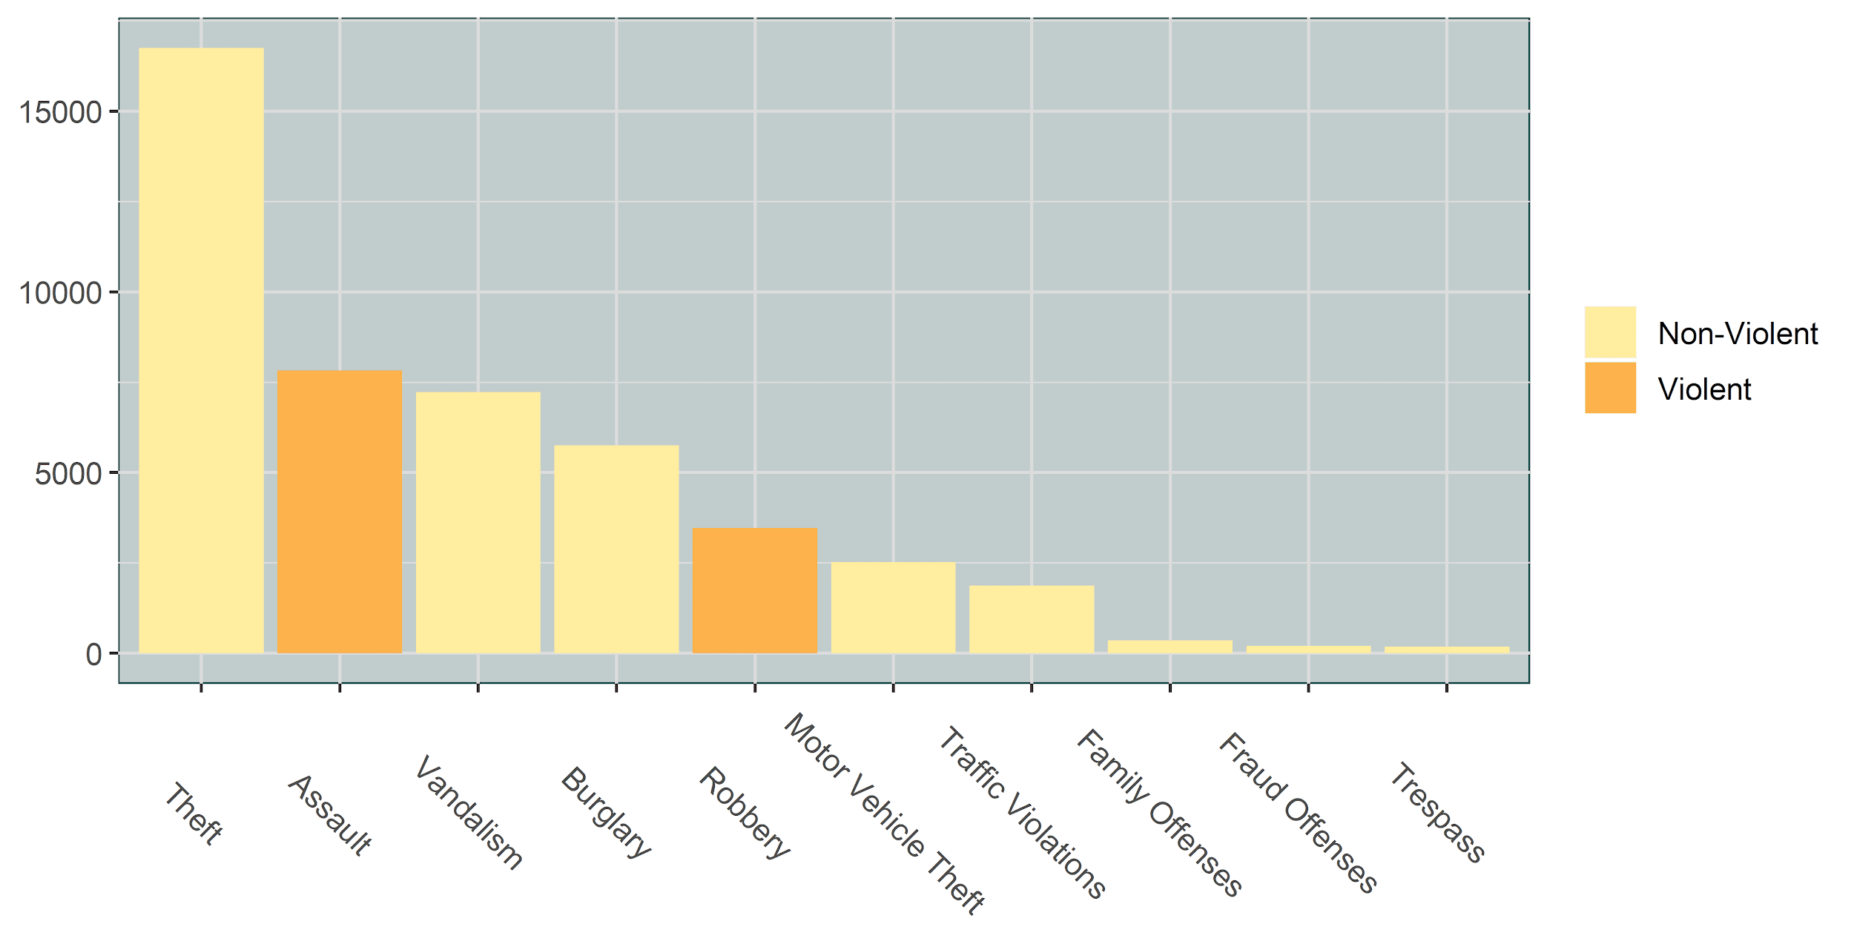
Top 10 Police Incidents

Slide 9
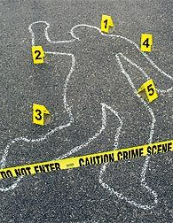
Violent Crimes
Crime categories that include Assault, Homicide or Robbery
This subset has just under 15,000 records from 2018

Slide 10
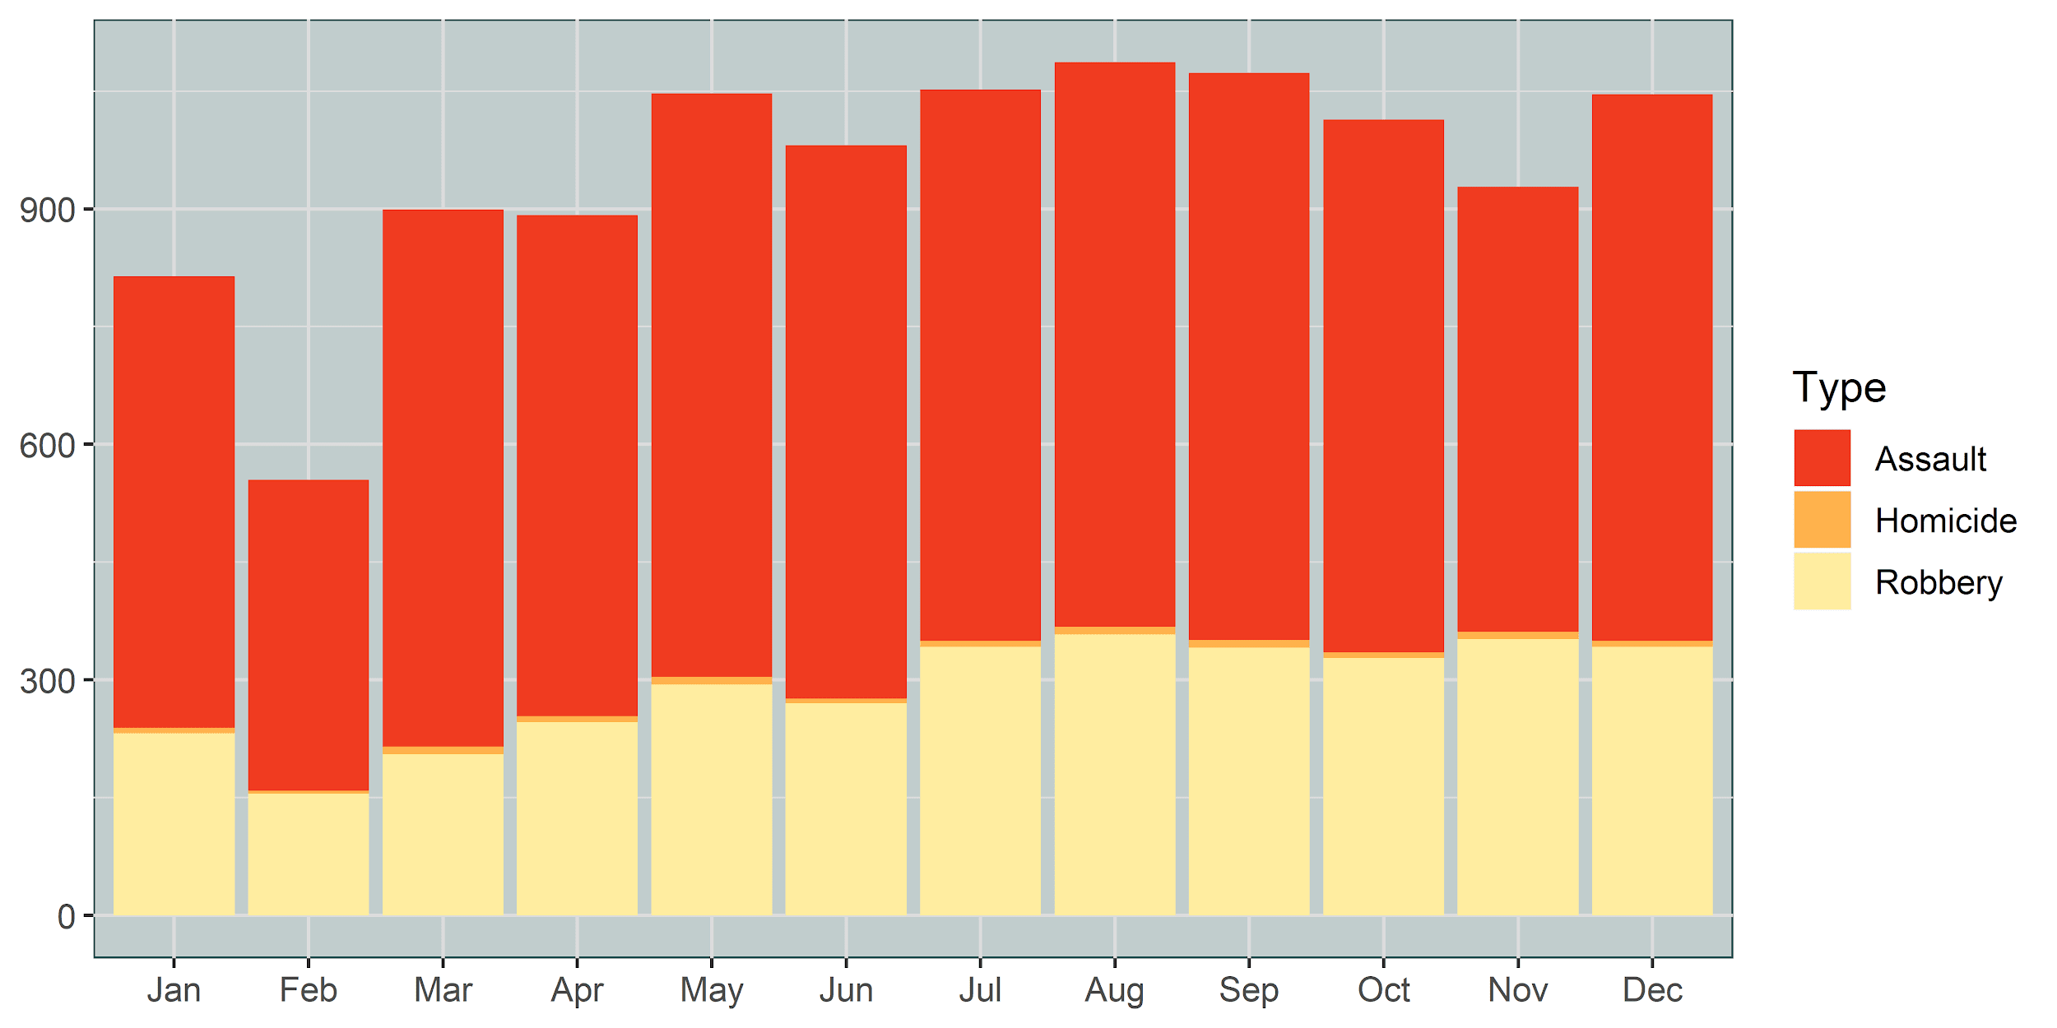
Violent Crime by Month

Slide 11
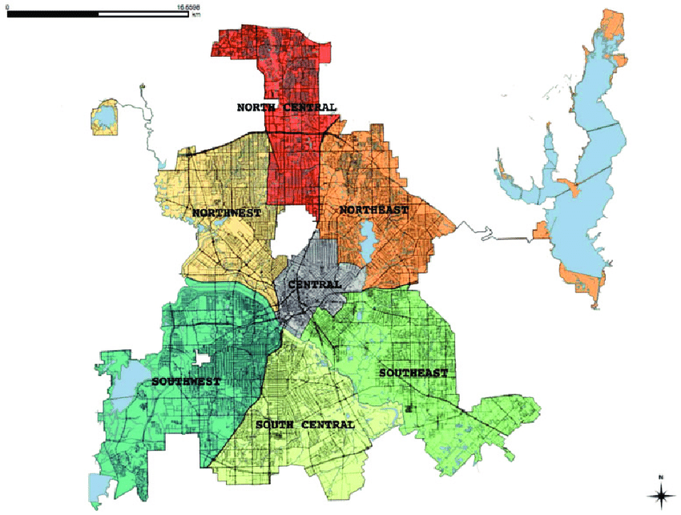
Divisions of Dallas

Slide 12
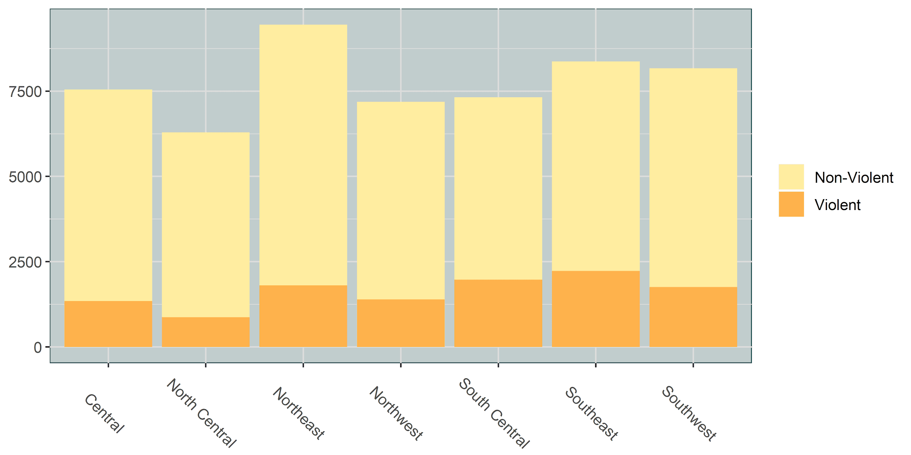
Total Police Incidents by Division

Slide 13
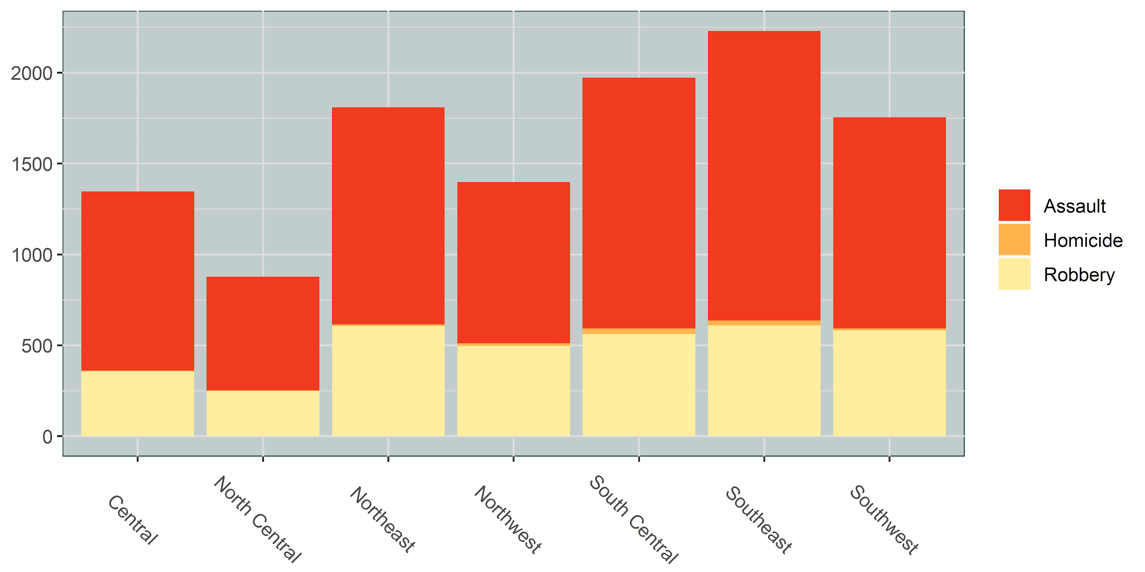
Violent Crimes by Division

Slide 14
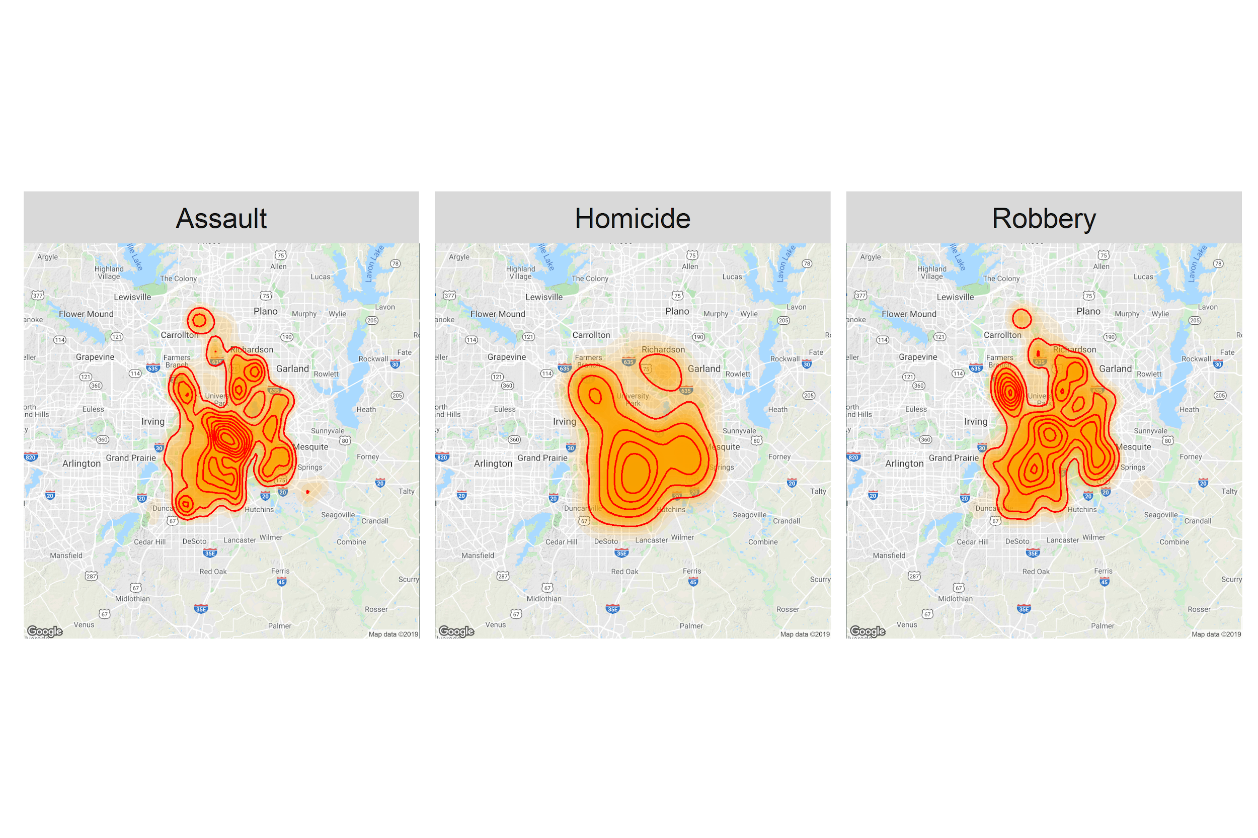
Concentration of Violent Crime

Slide 15
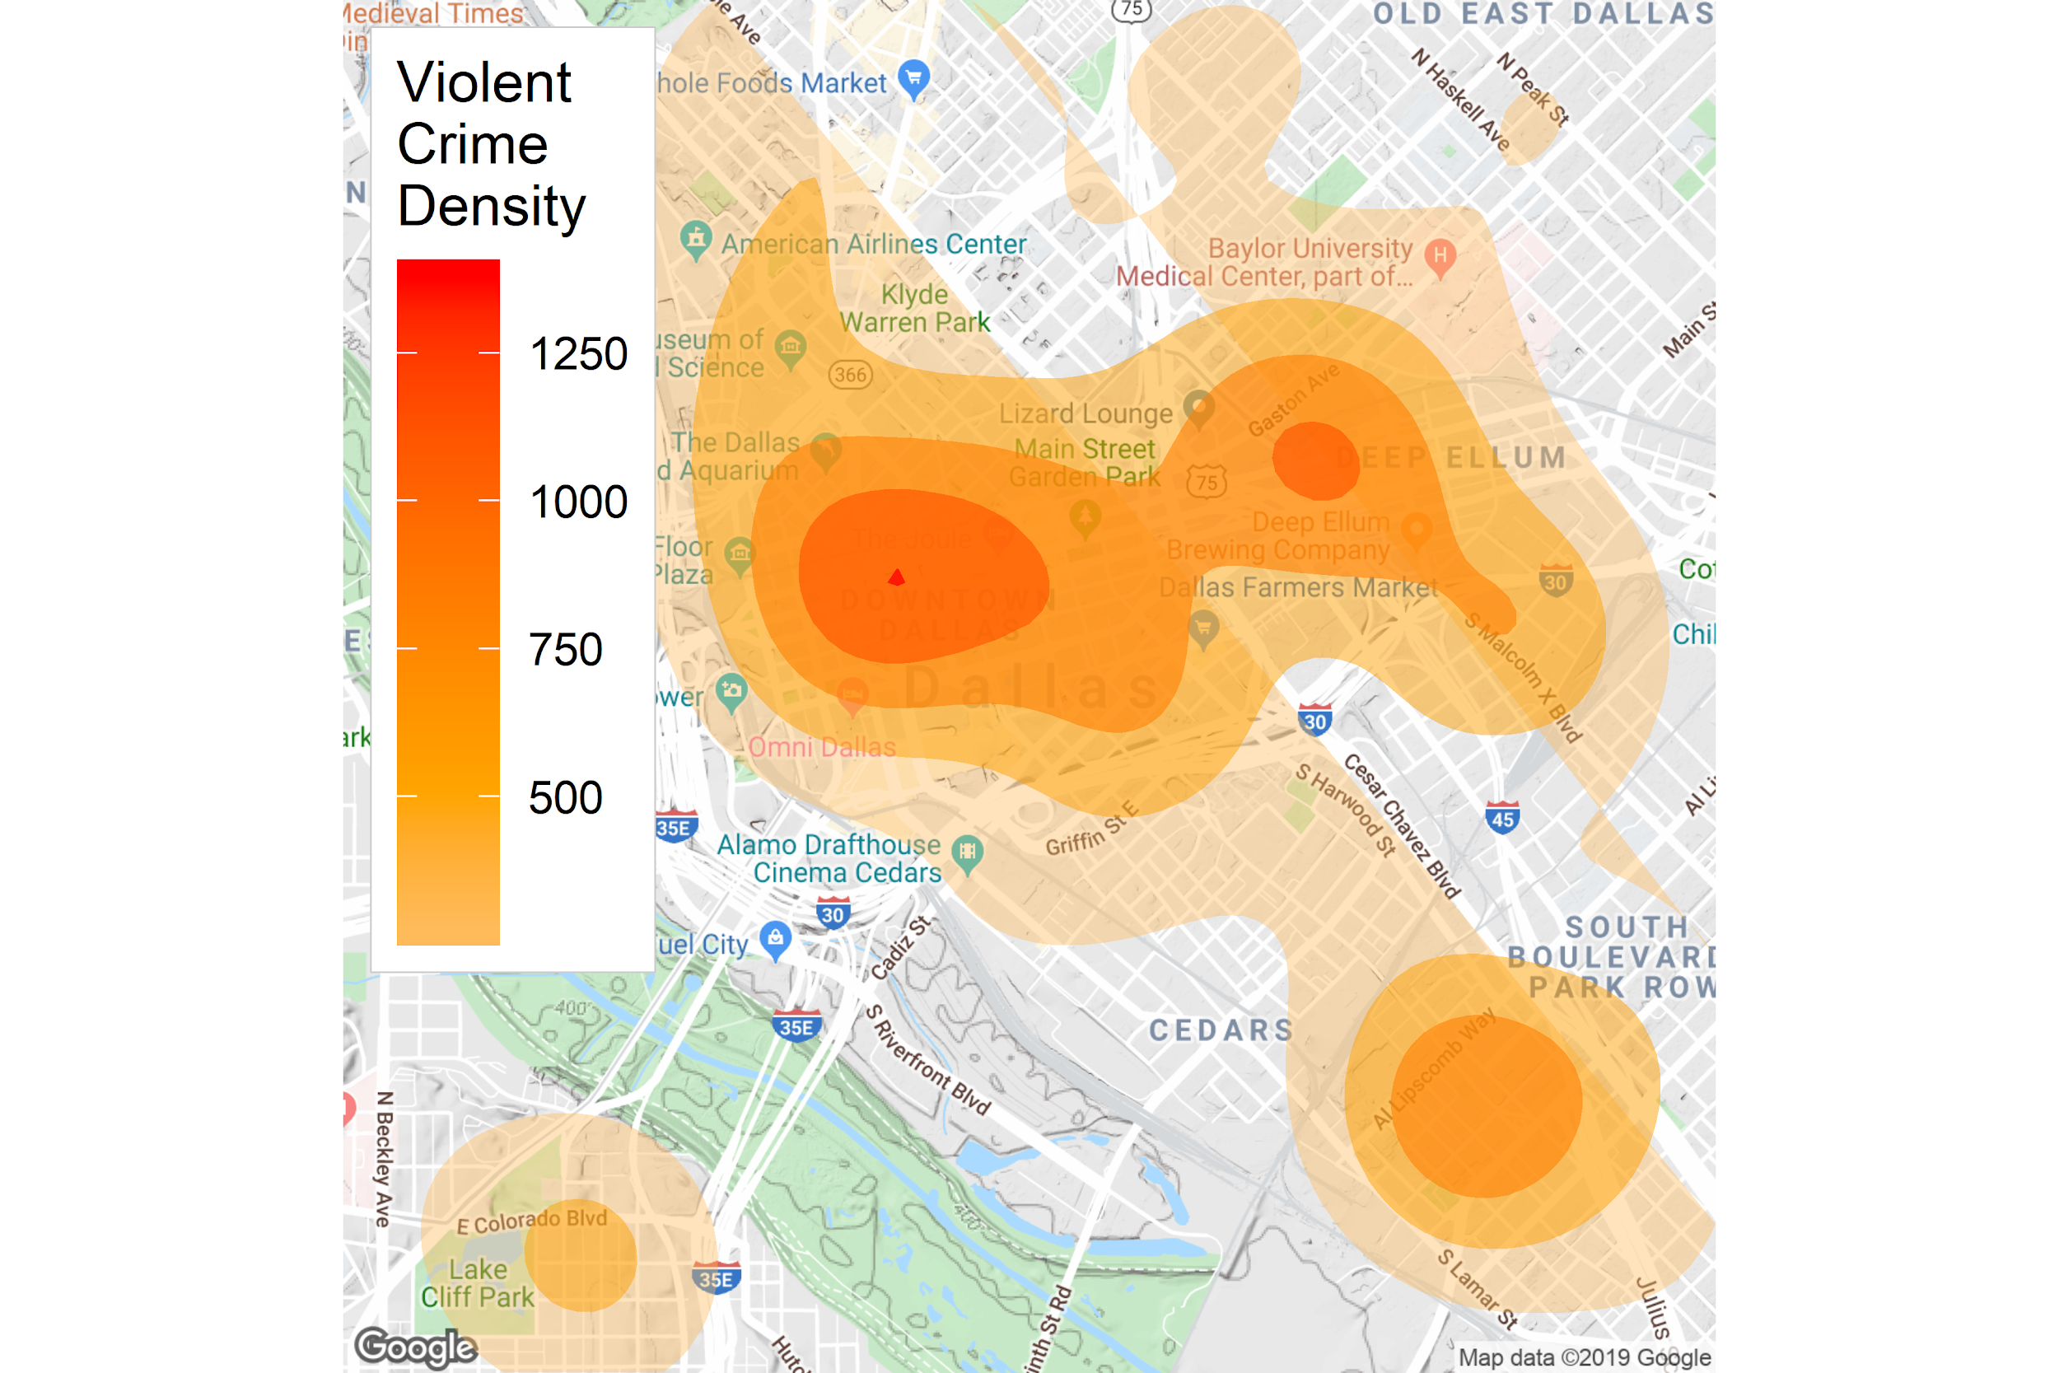
Overall Violent Crime Density

Slide 16
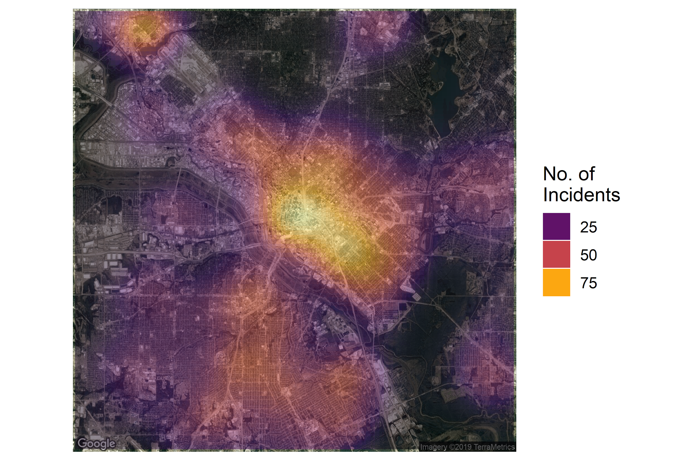
Heat Map of Crimes

Slide 17
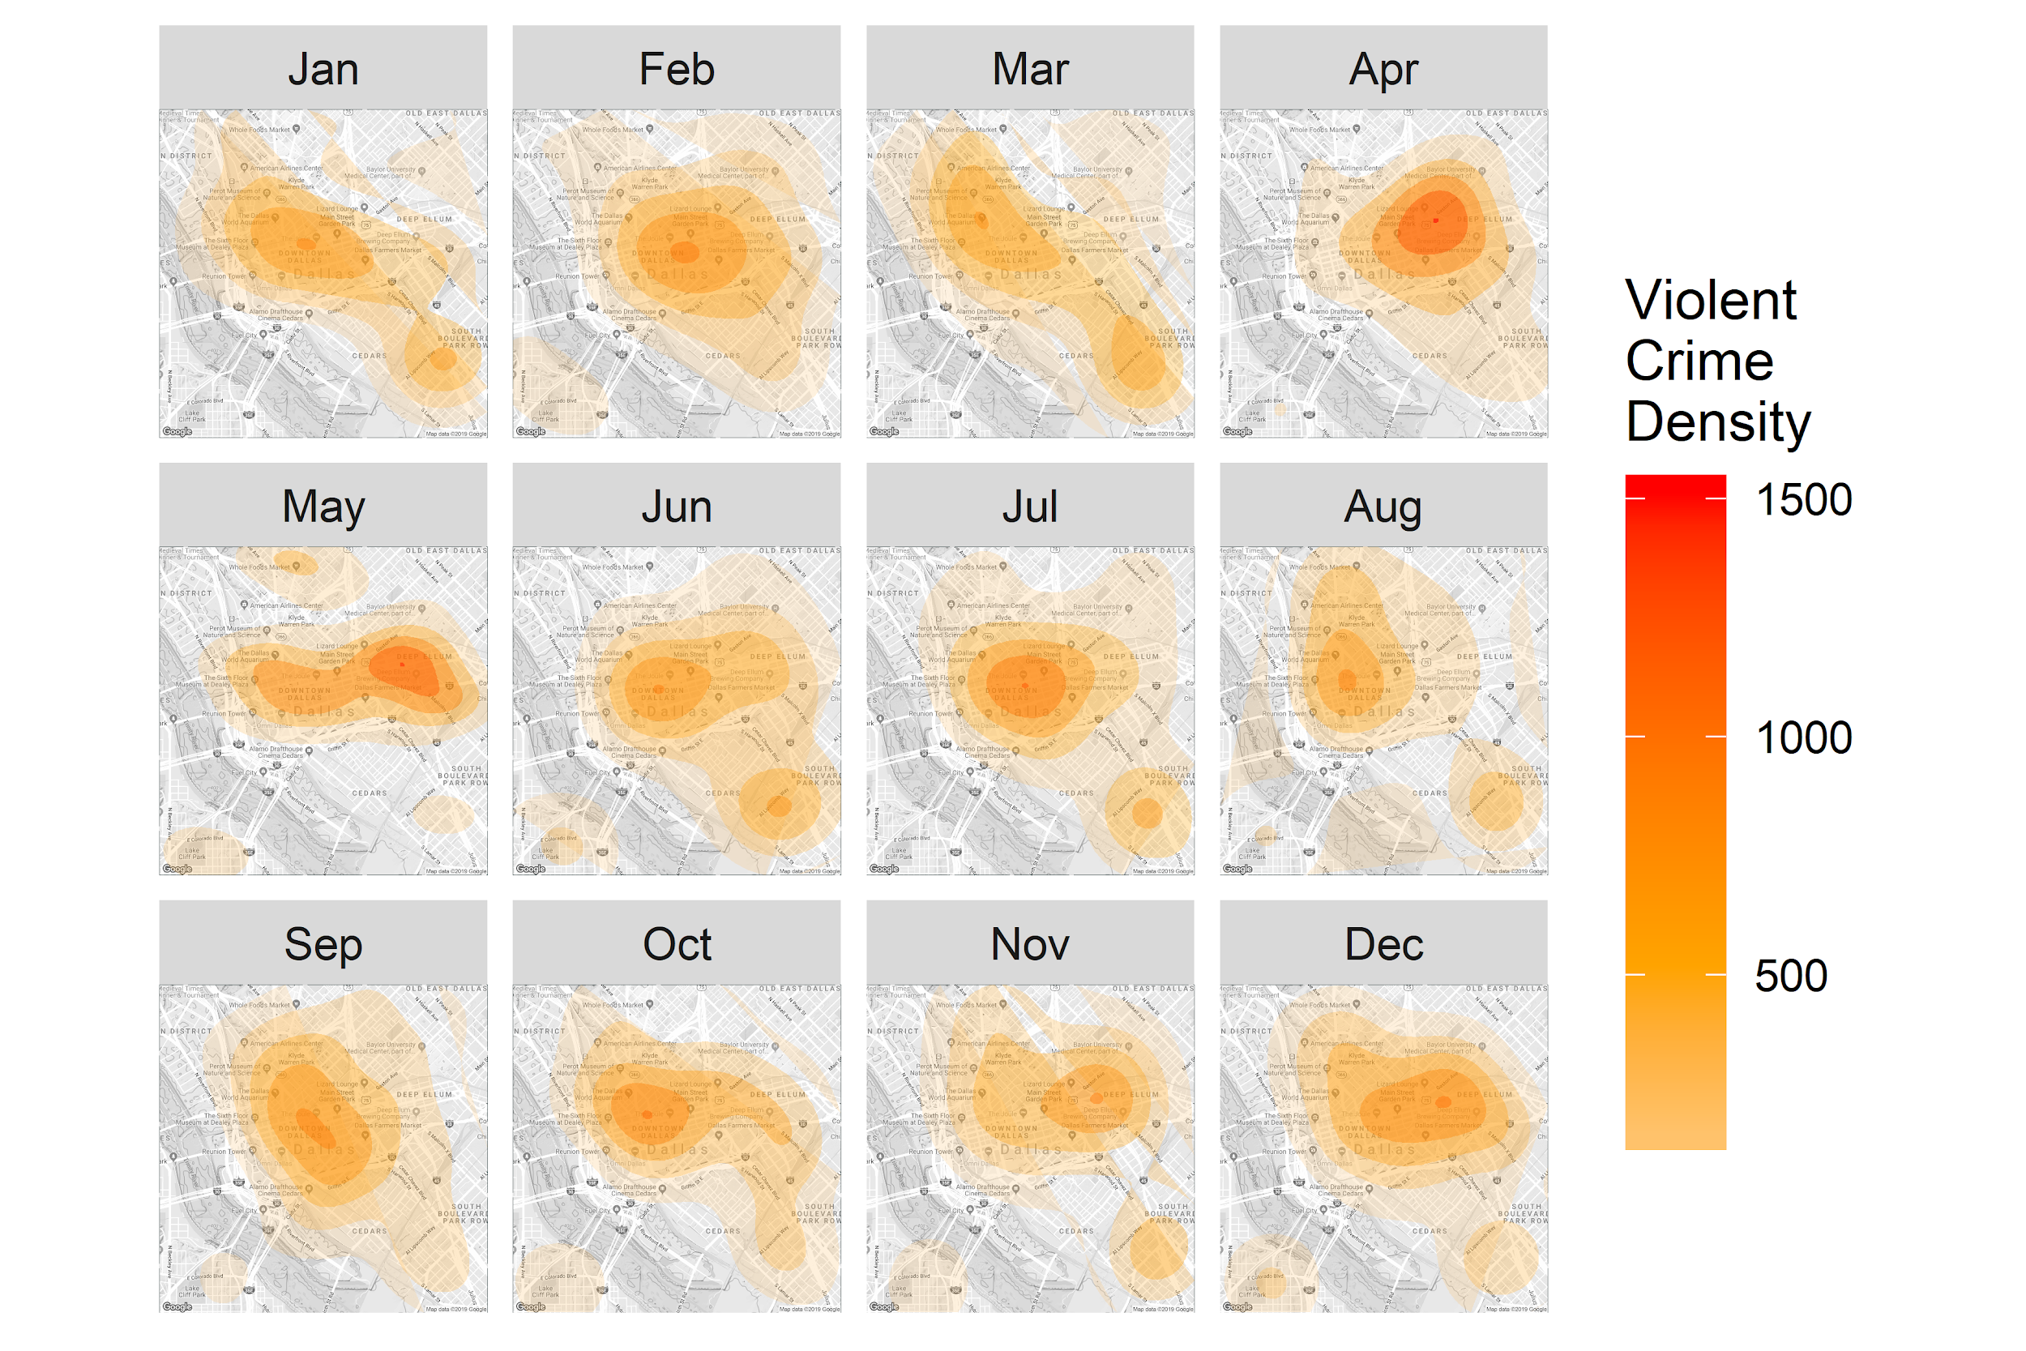
Violent Crime Density by Month

Slide 18
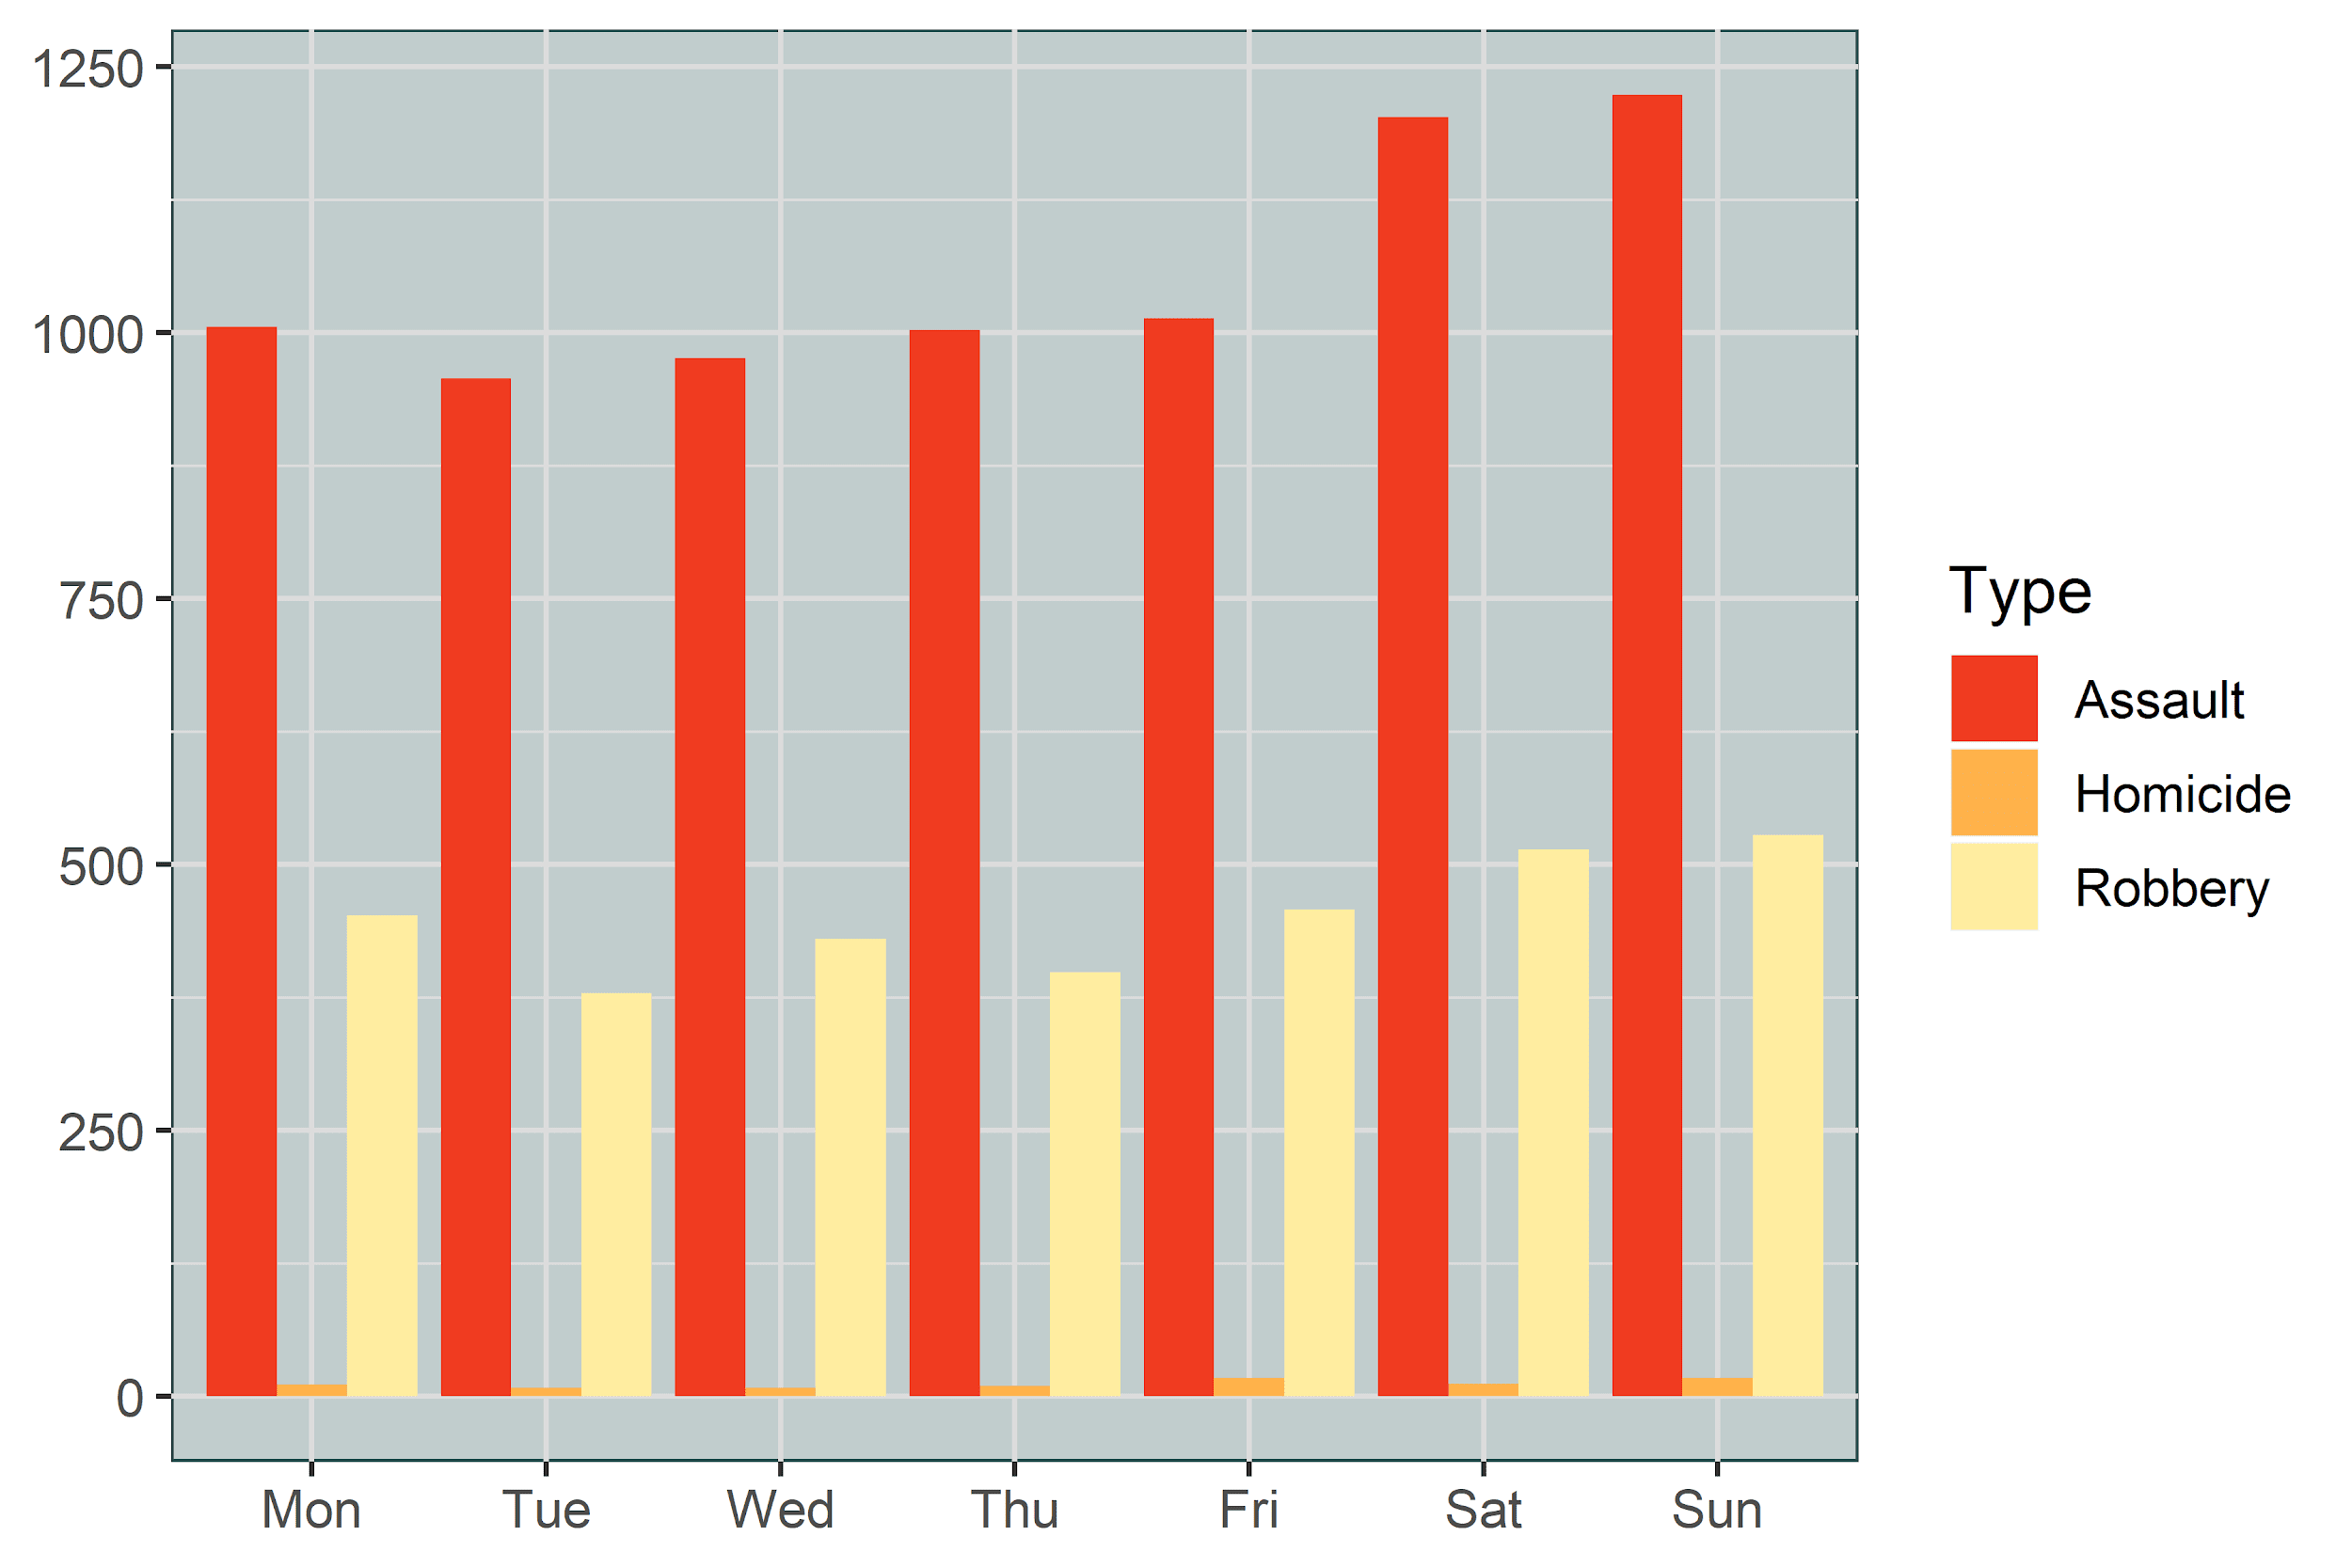
Violent Crime by Day of Week

Slide 19
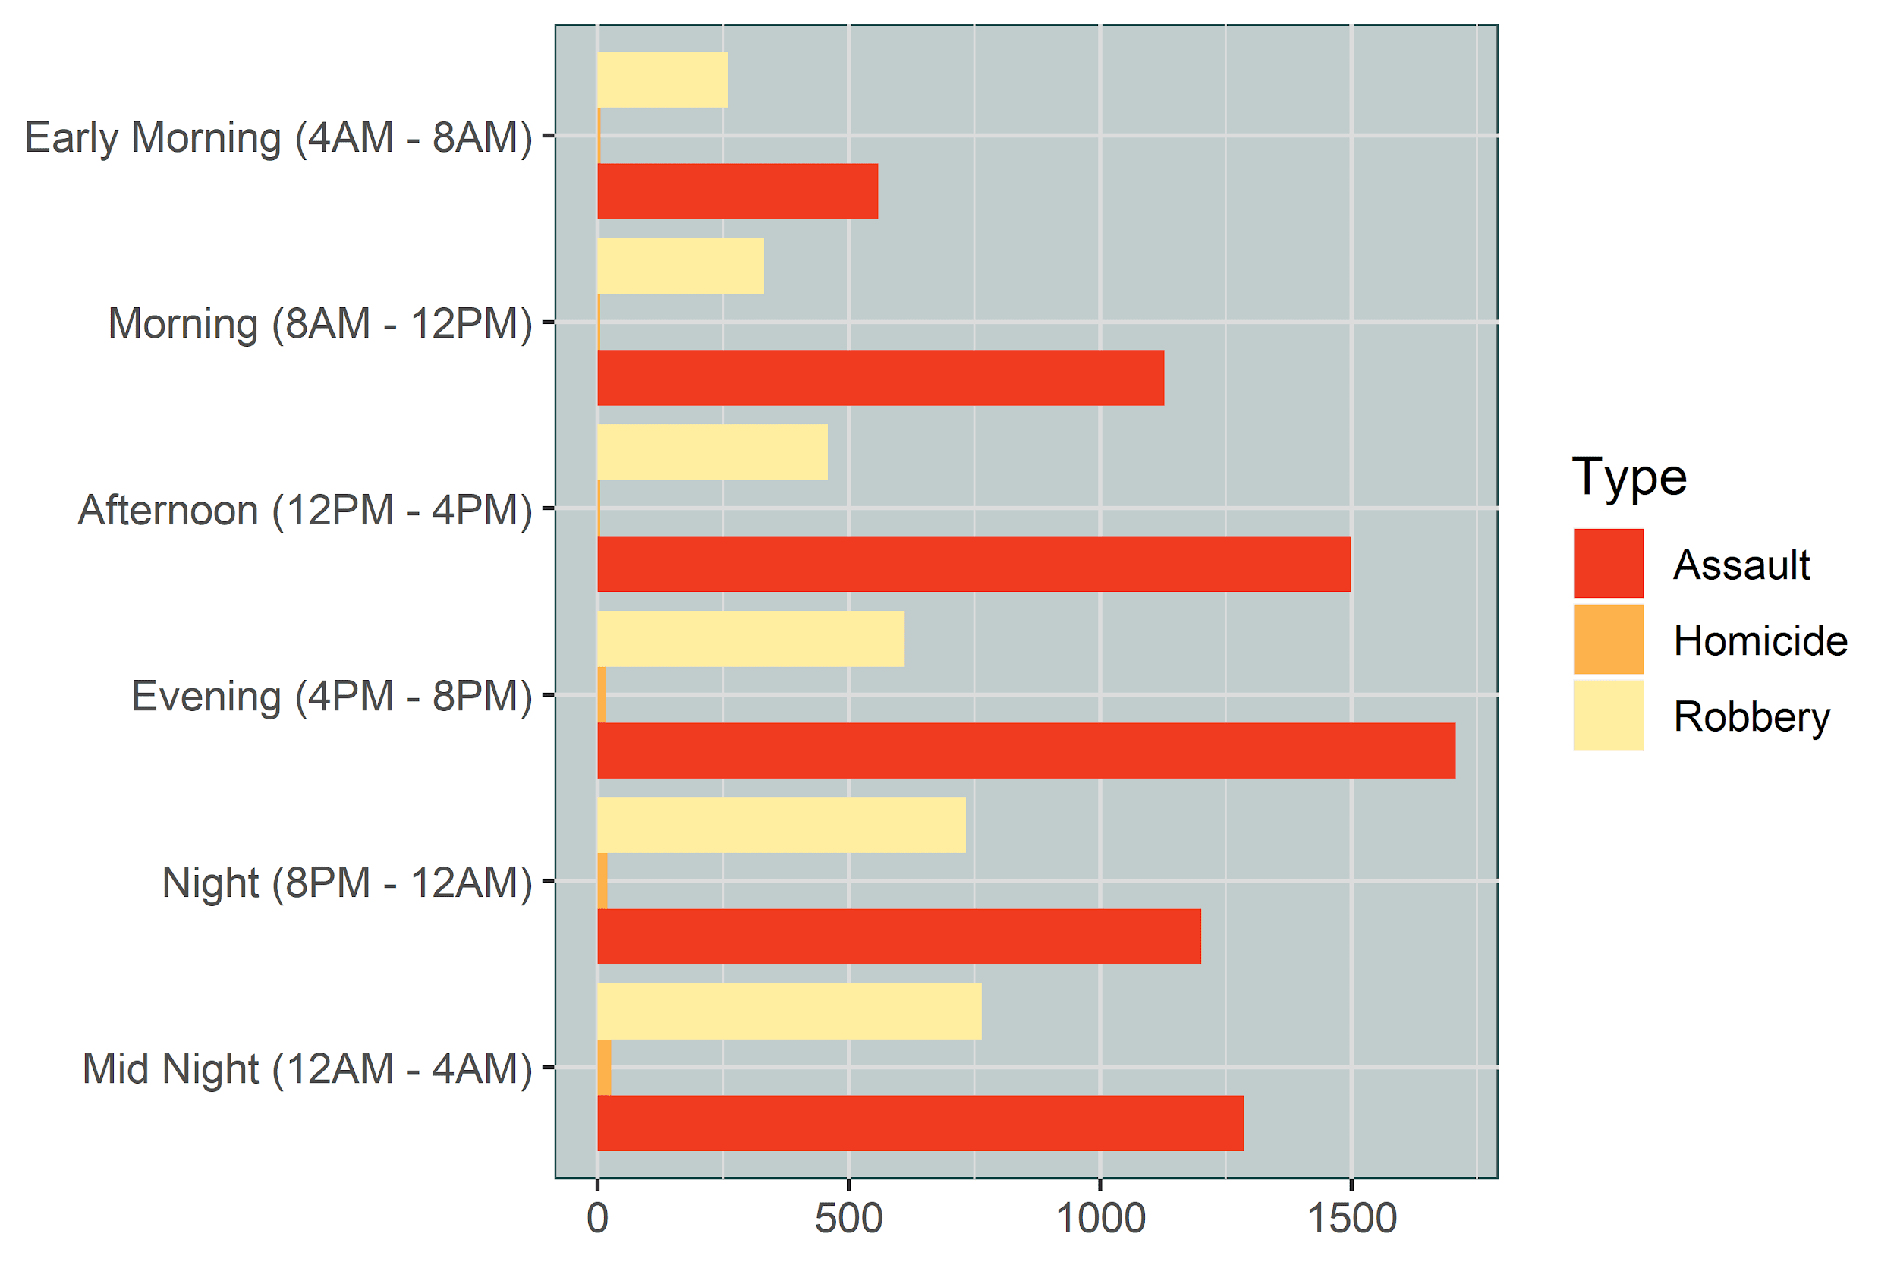
Violent Crime by Time of Day

Slide 20
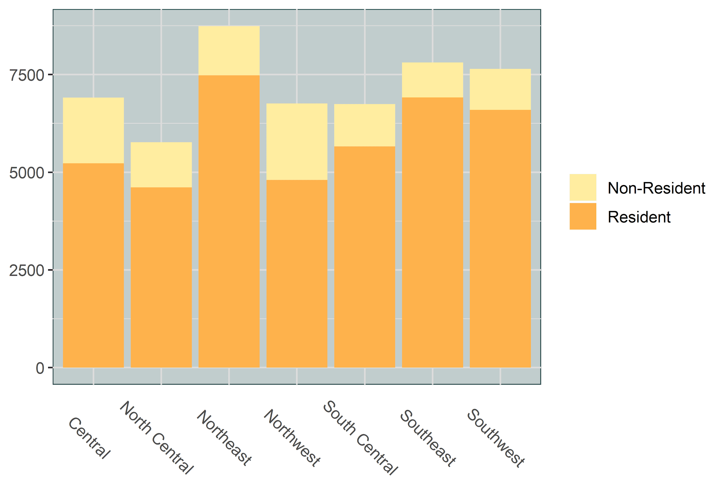

Victim Crime by Residency

Slide 21
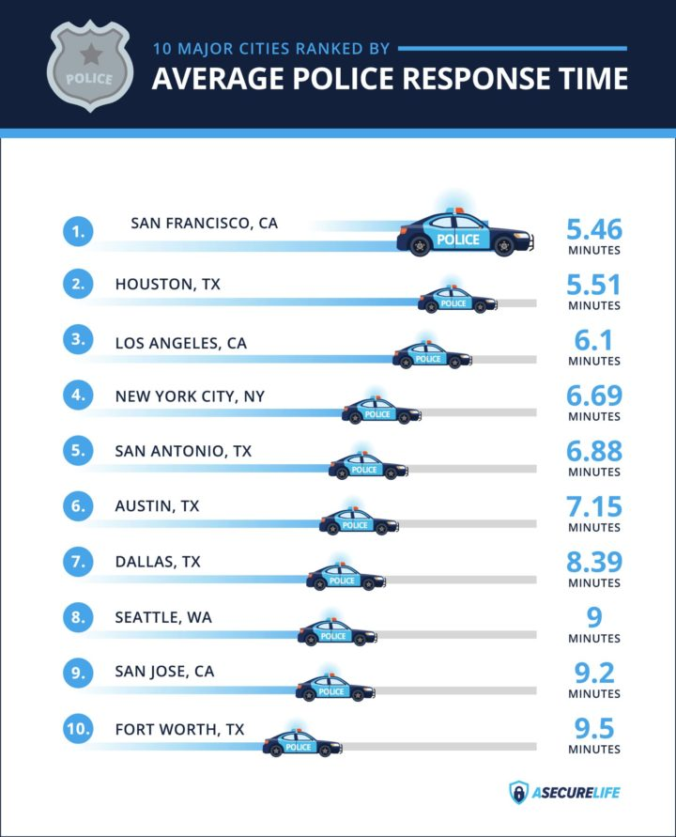
Response Time of Dallas Police
Time taken for the officer to arrive at the scene after a 911 call.
Differs from city to city based on factors like city population, police funding, and available resources.
Rapidly growing cities simply outpace police department’s ability to scale their resources.
It’s hard to give an accurate average when it comes to police response times.
Most cities aim to maintain an average response time of around five to six minutes for their highest-priority calls.

Slide 22
Response Time of Dallas Police
Time between Call Received Time and Call Dispatch Time.
Using the “median” response time as opposed to “mean” as it skews the data due to more outliers.
The Speed of response time is broken down into four categories as (Fastest, Fast, Slow and Slowest).
Based on our data, the average response time of Dallas Police for all types of calls is 113 minutes and median response time is 17 minutes.

Slide 23
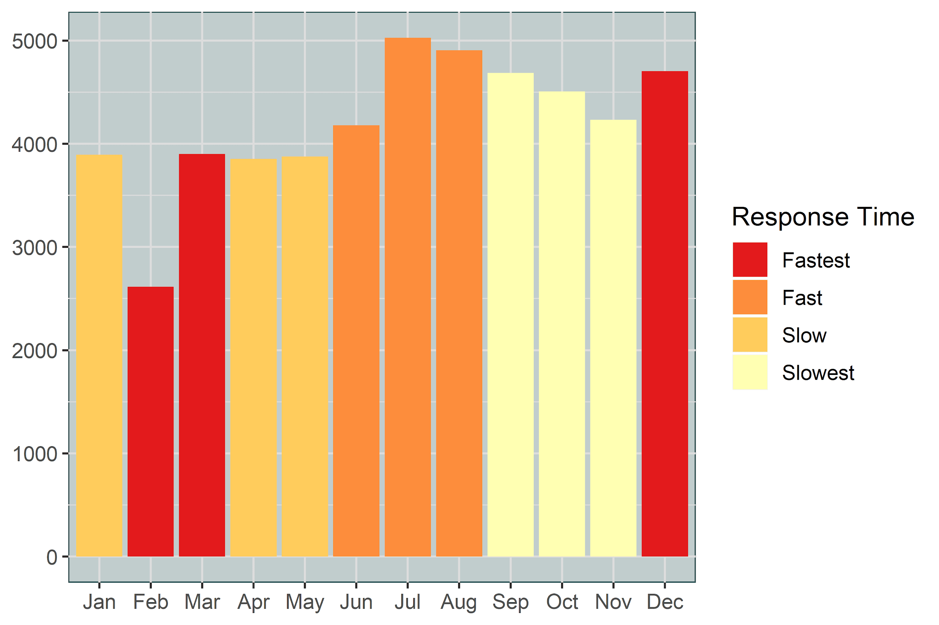
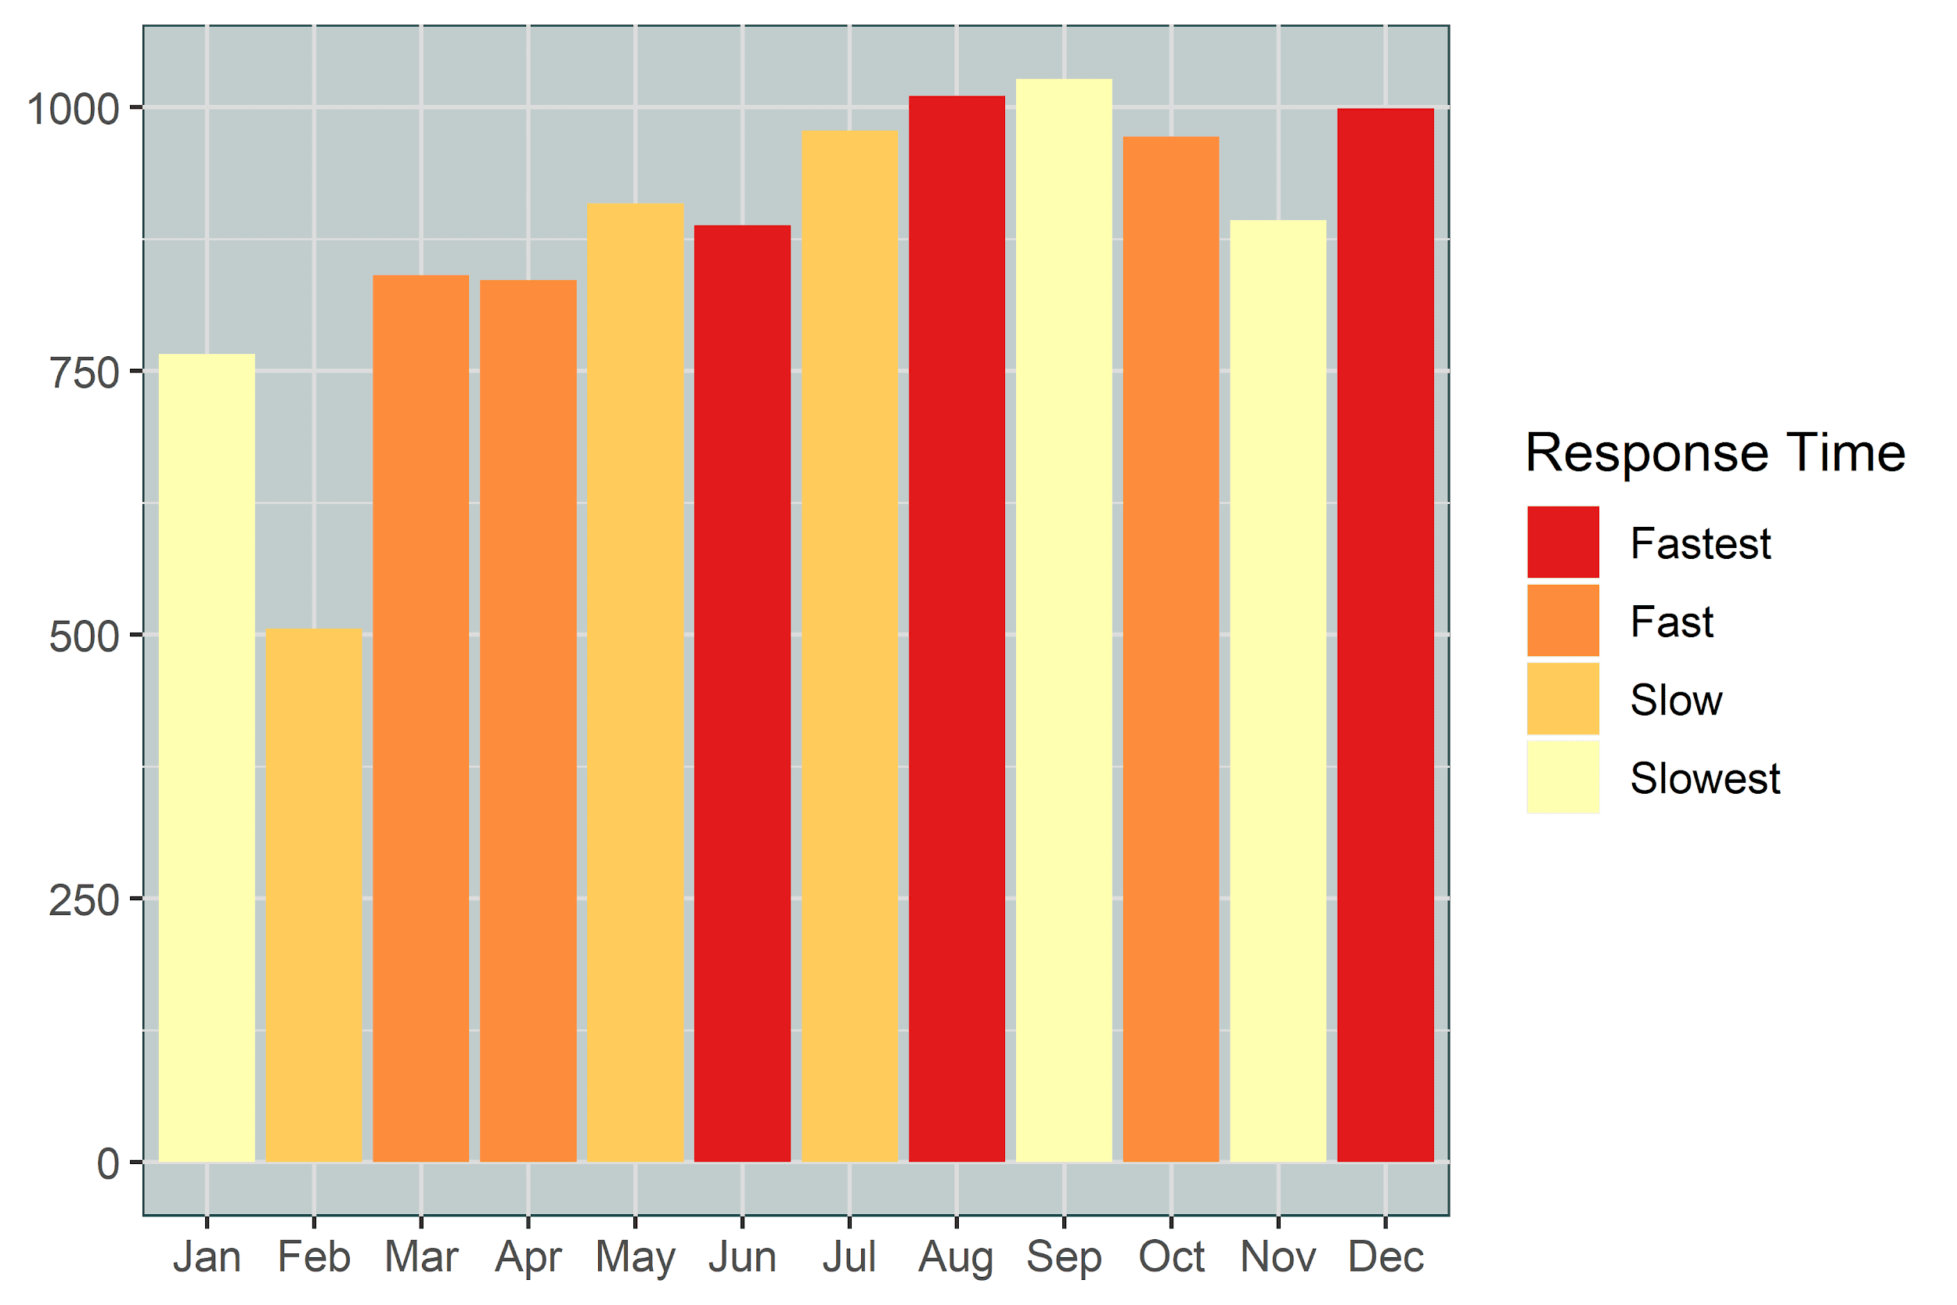
Responsiveness by Month
All Crimes
Violent Crimes

Slide 24
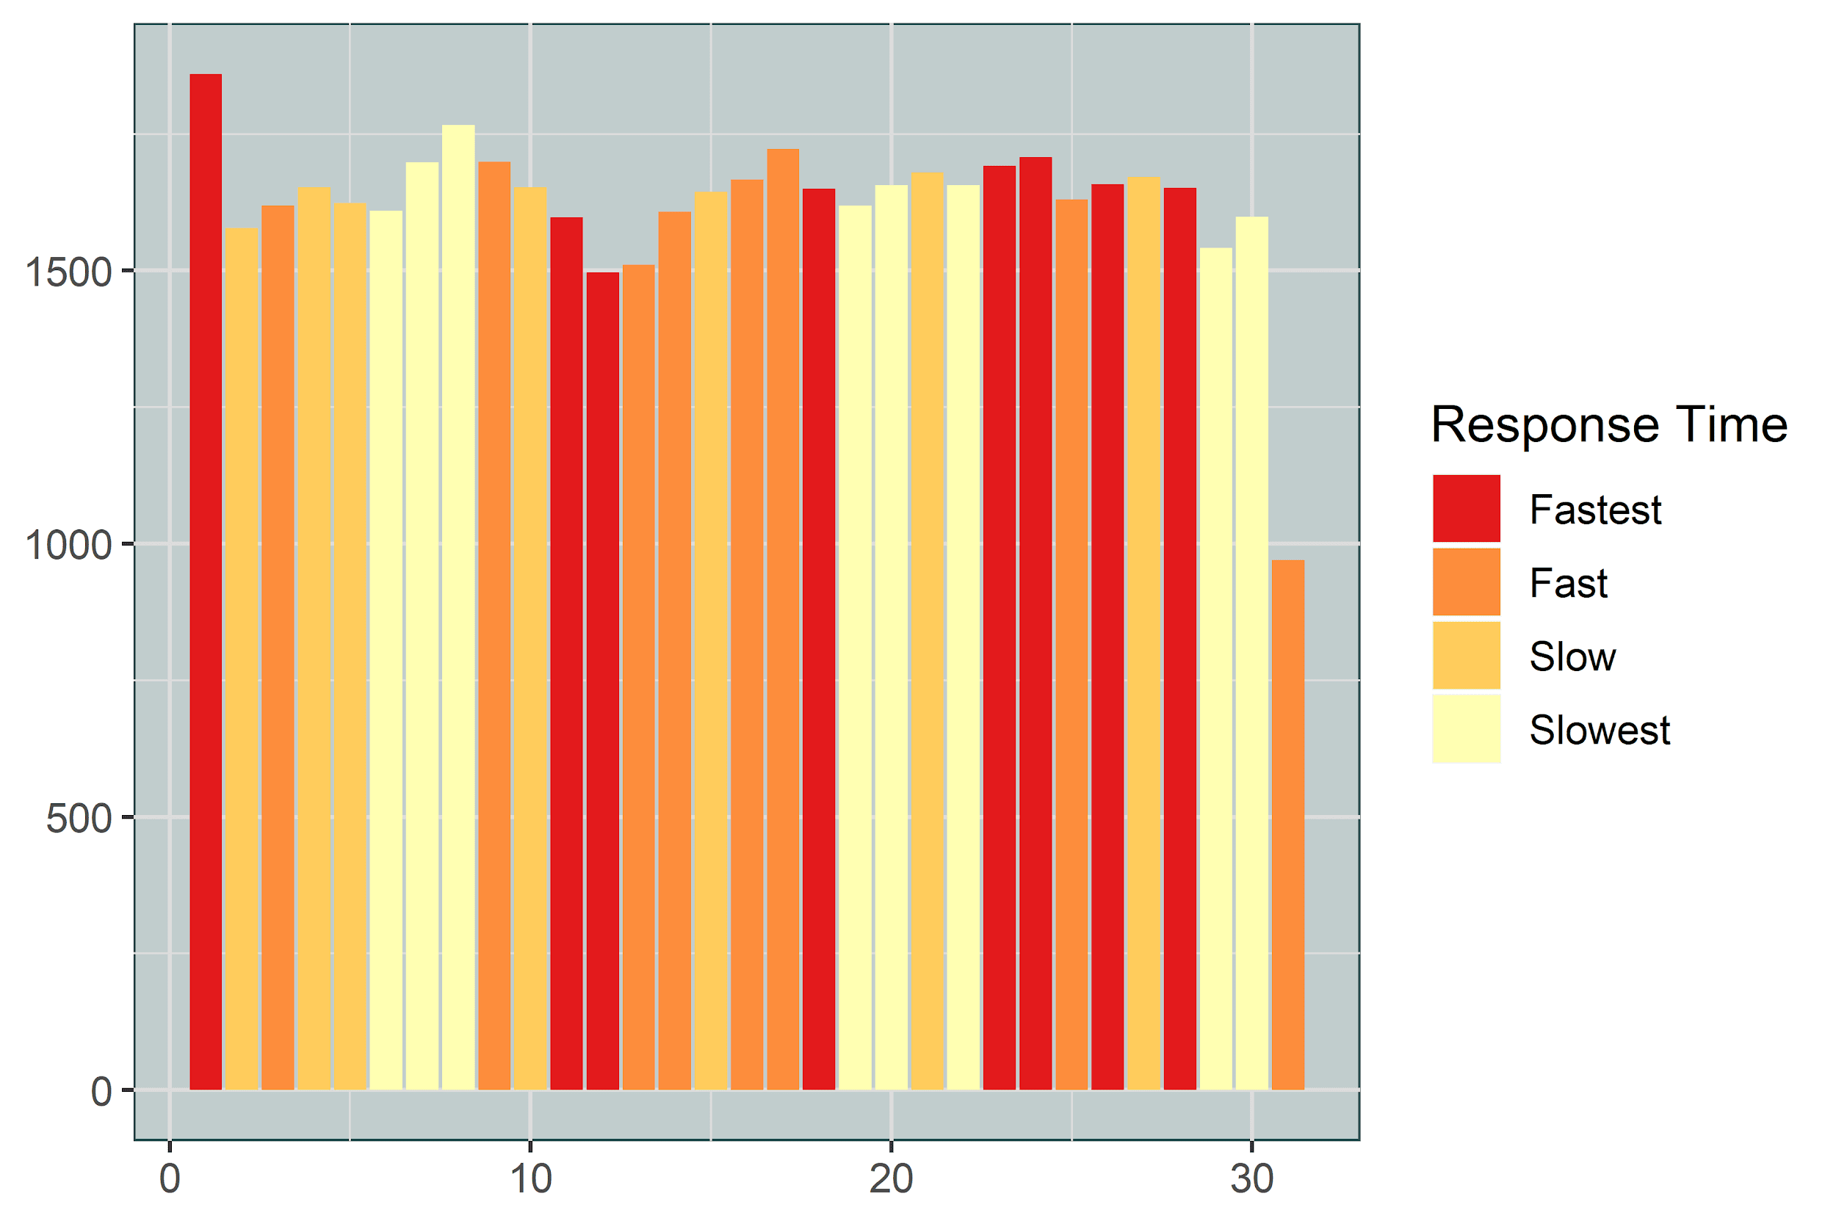
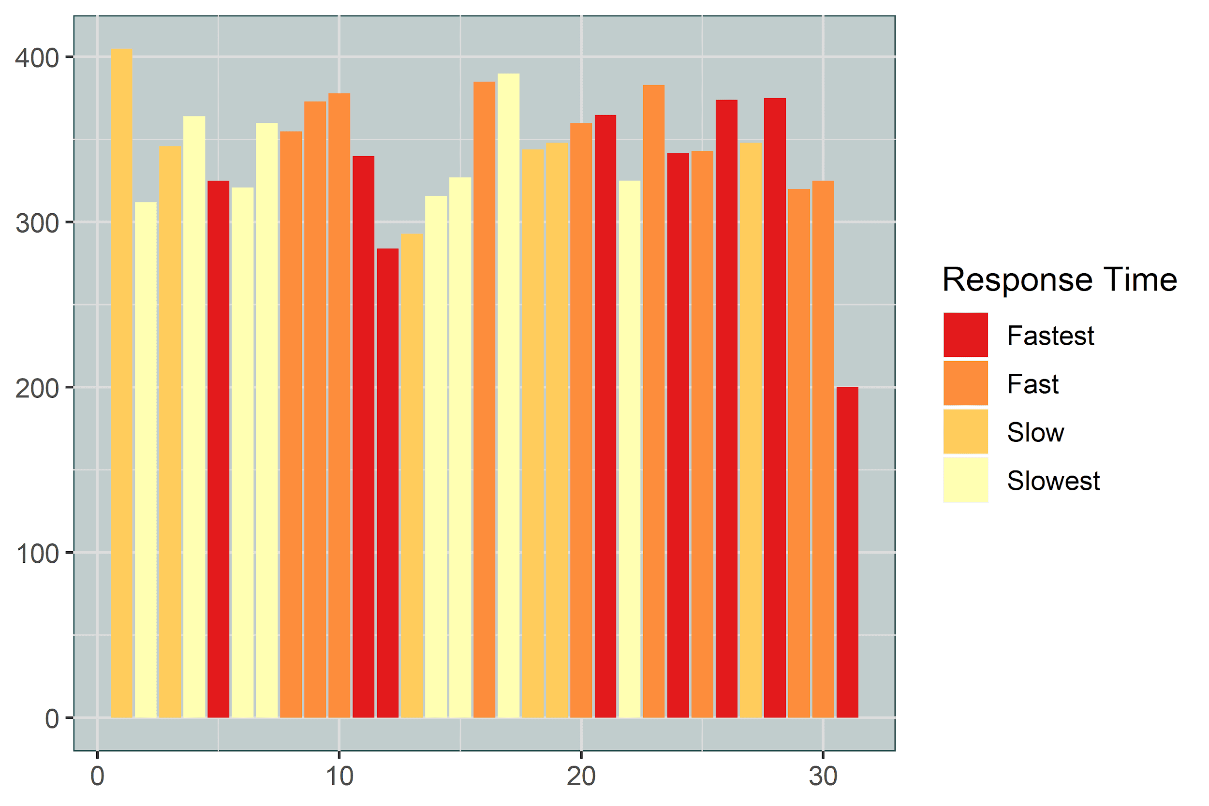
Which day of Month are they most responsive?
All Crimes
Violent Crimes

Slide 25
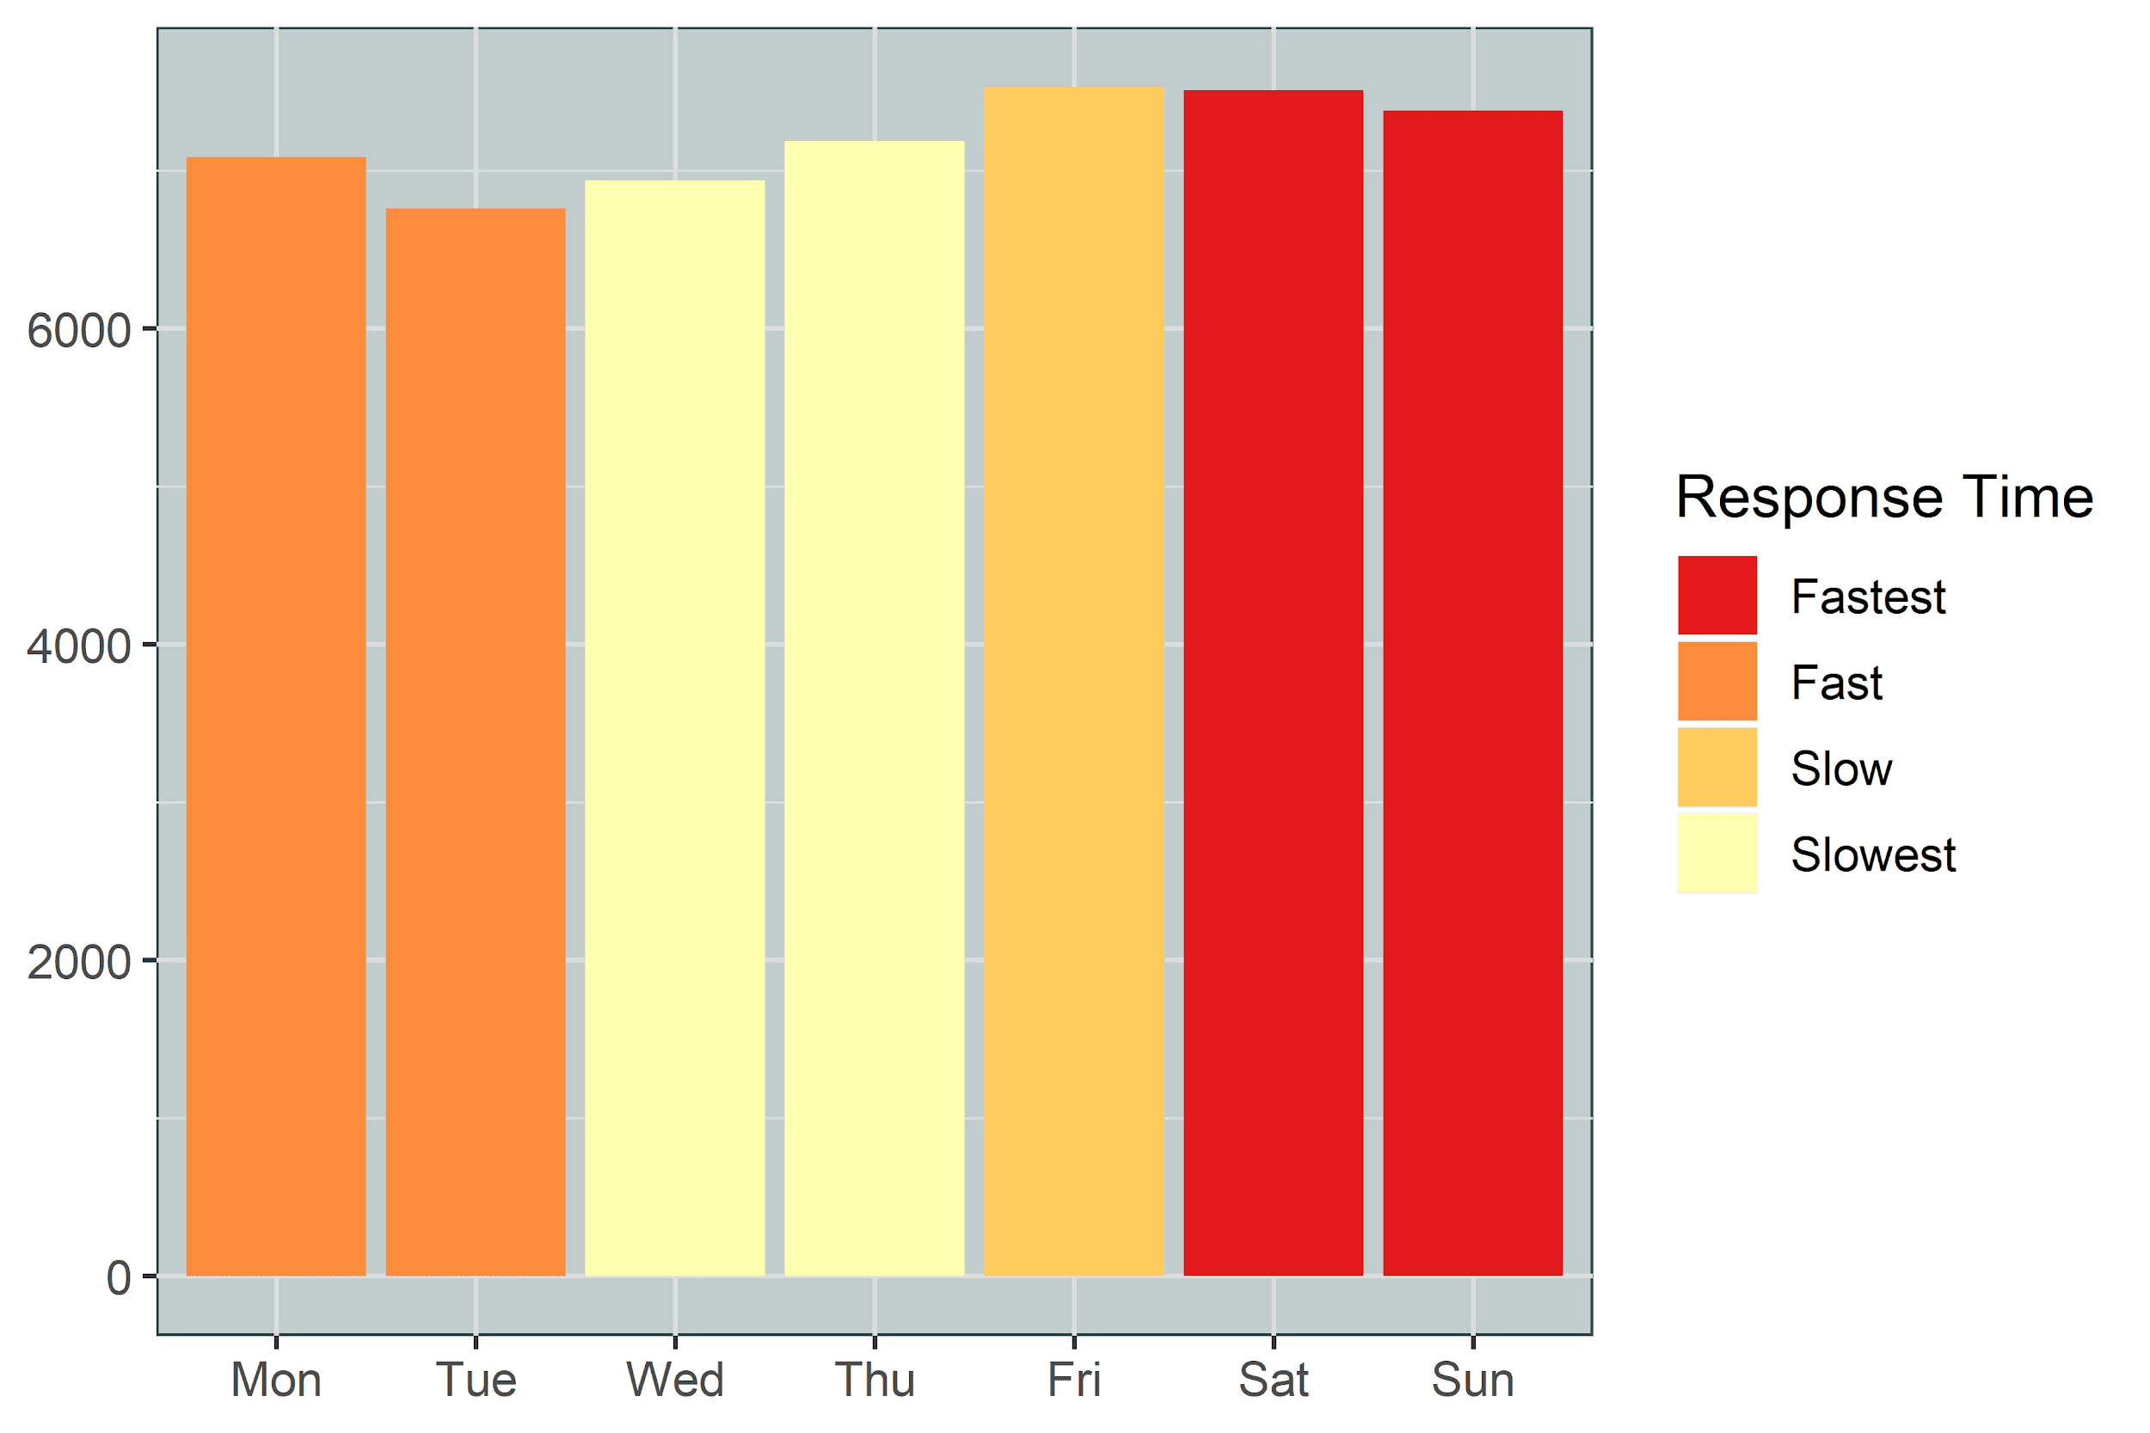
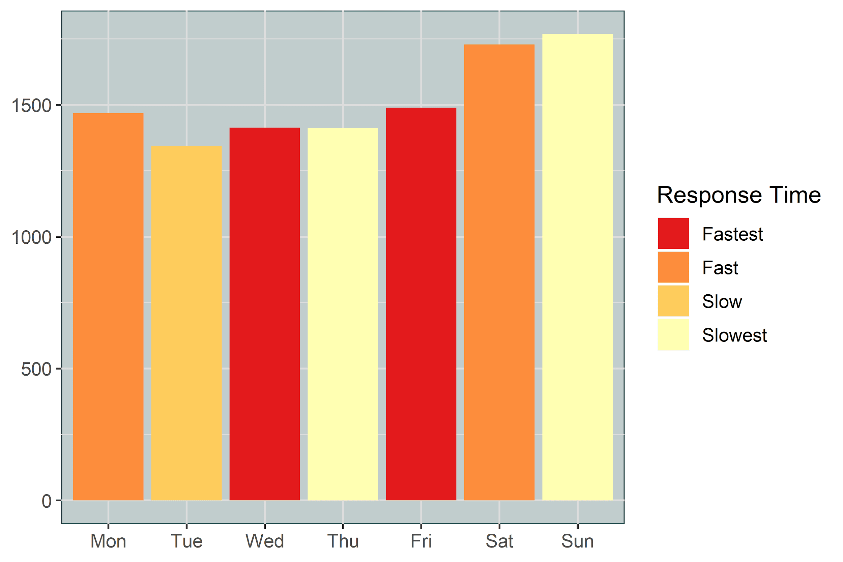
Which day turns out most responsive?
All Crimes
Violent Crimes

Slide 26
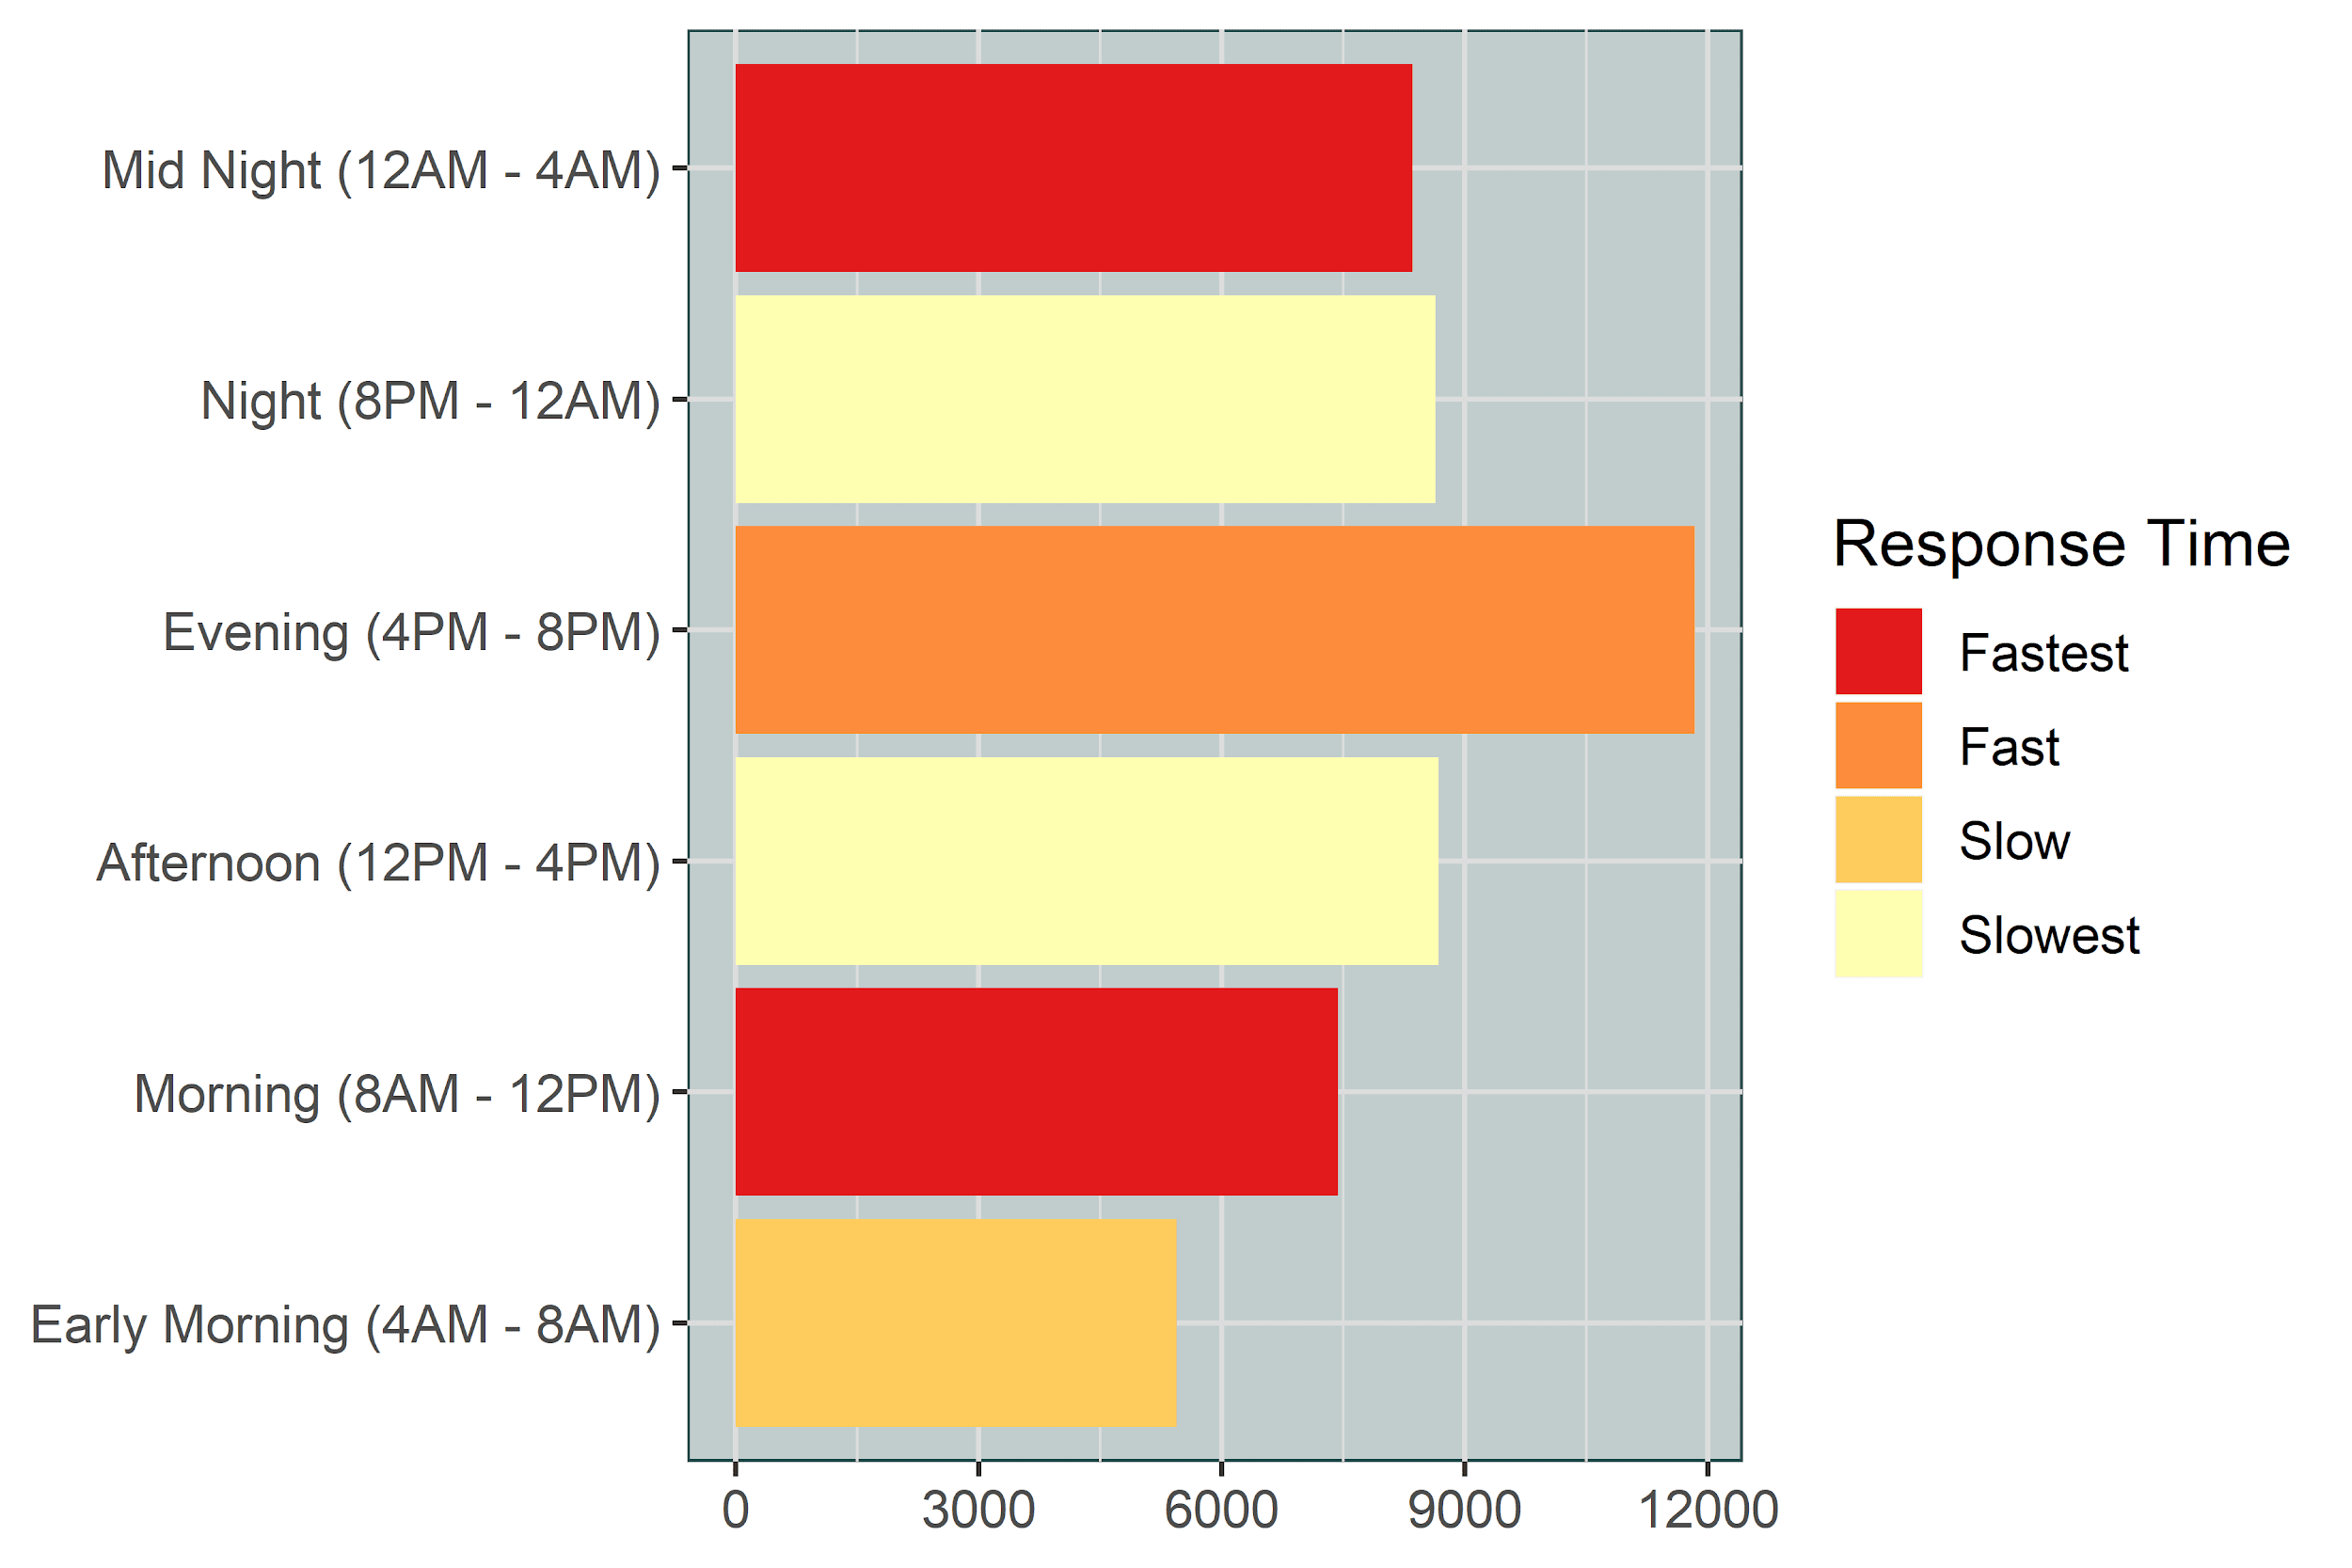
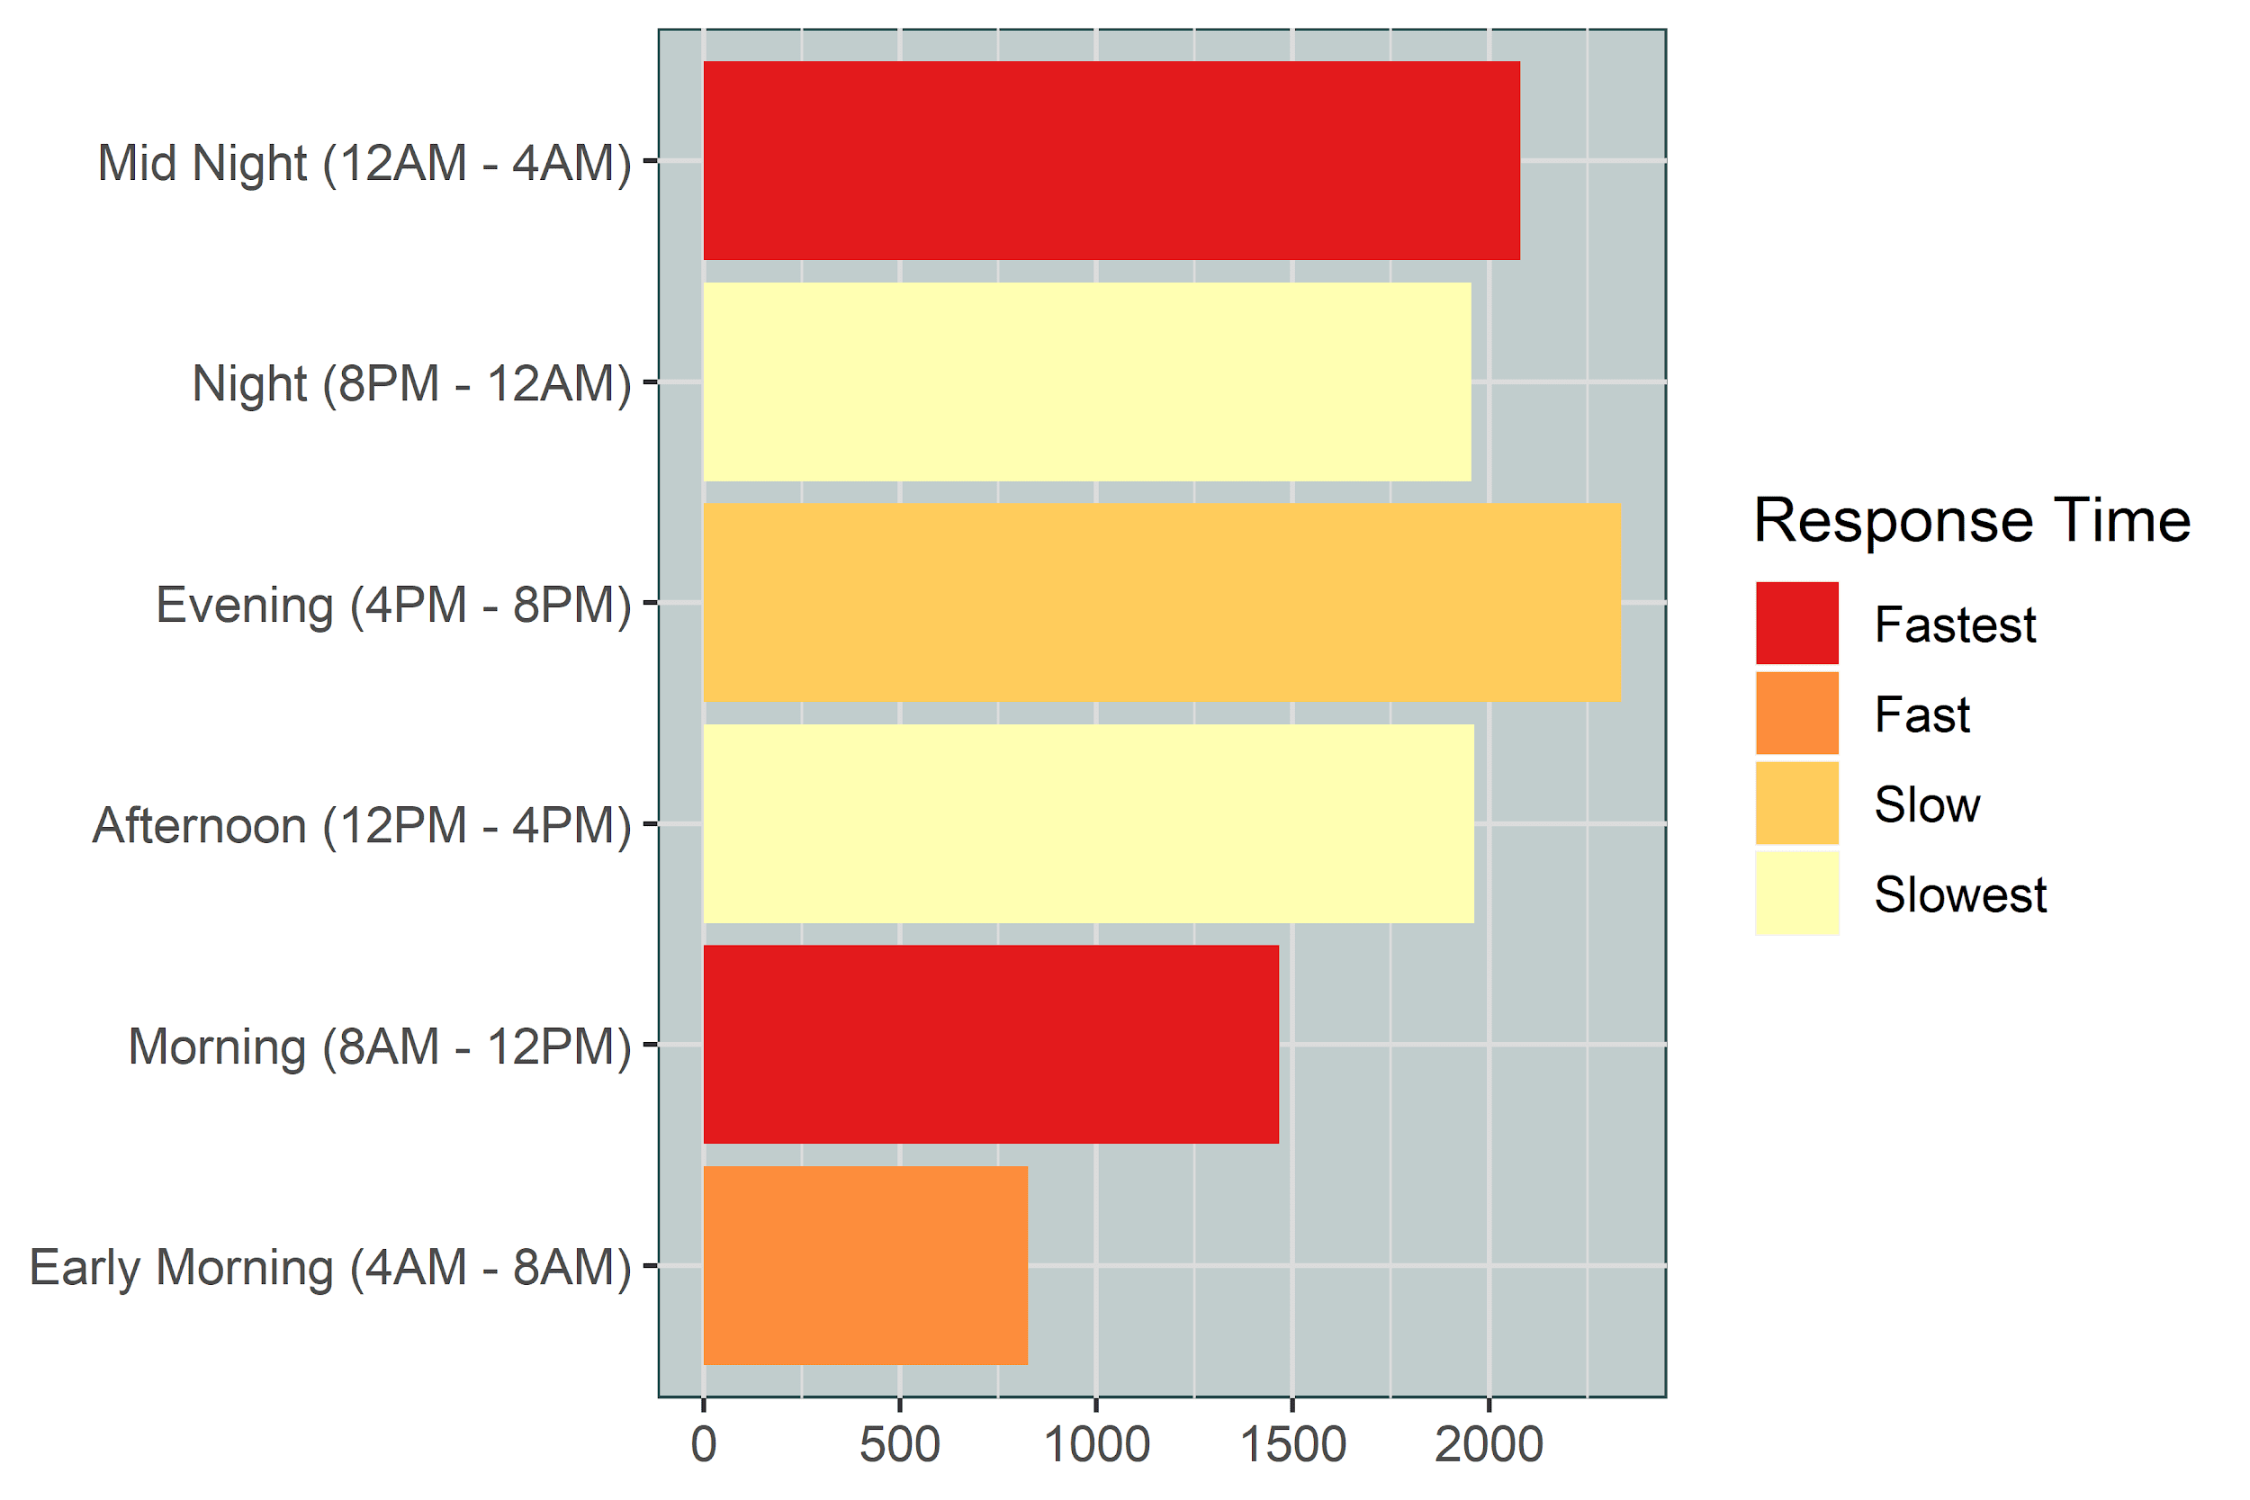
What time period are they most responsive?
All Crimes
Violent Crimes

Slide 27
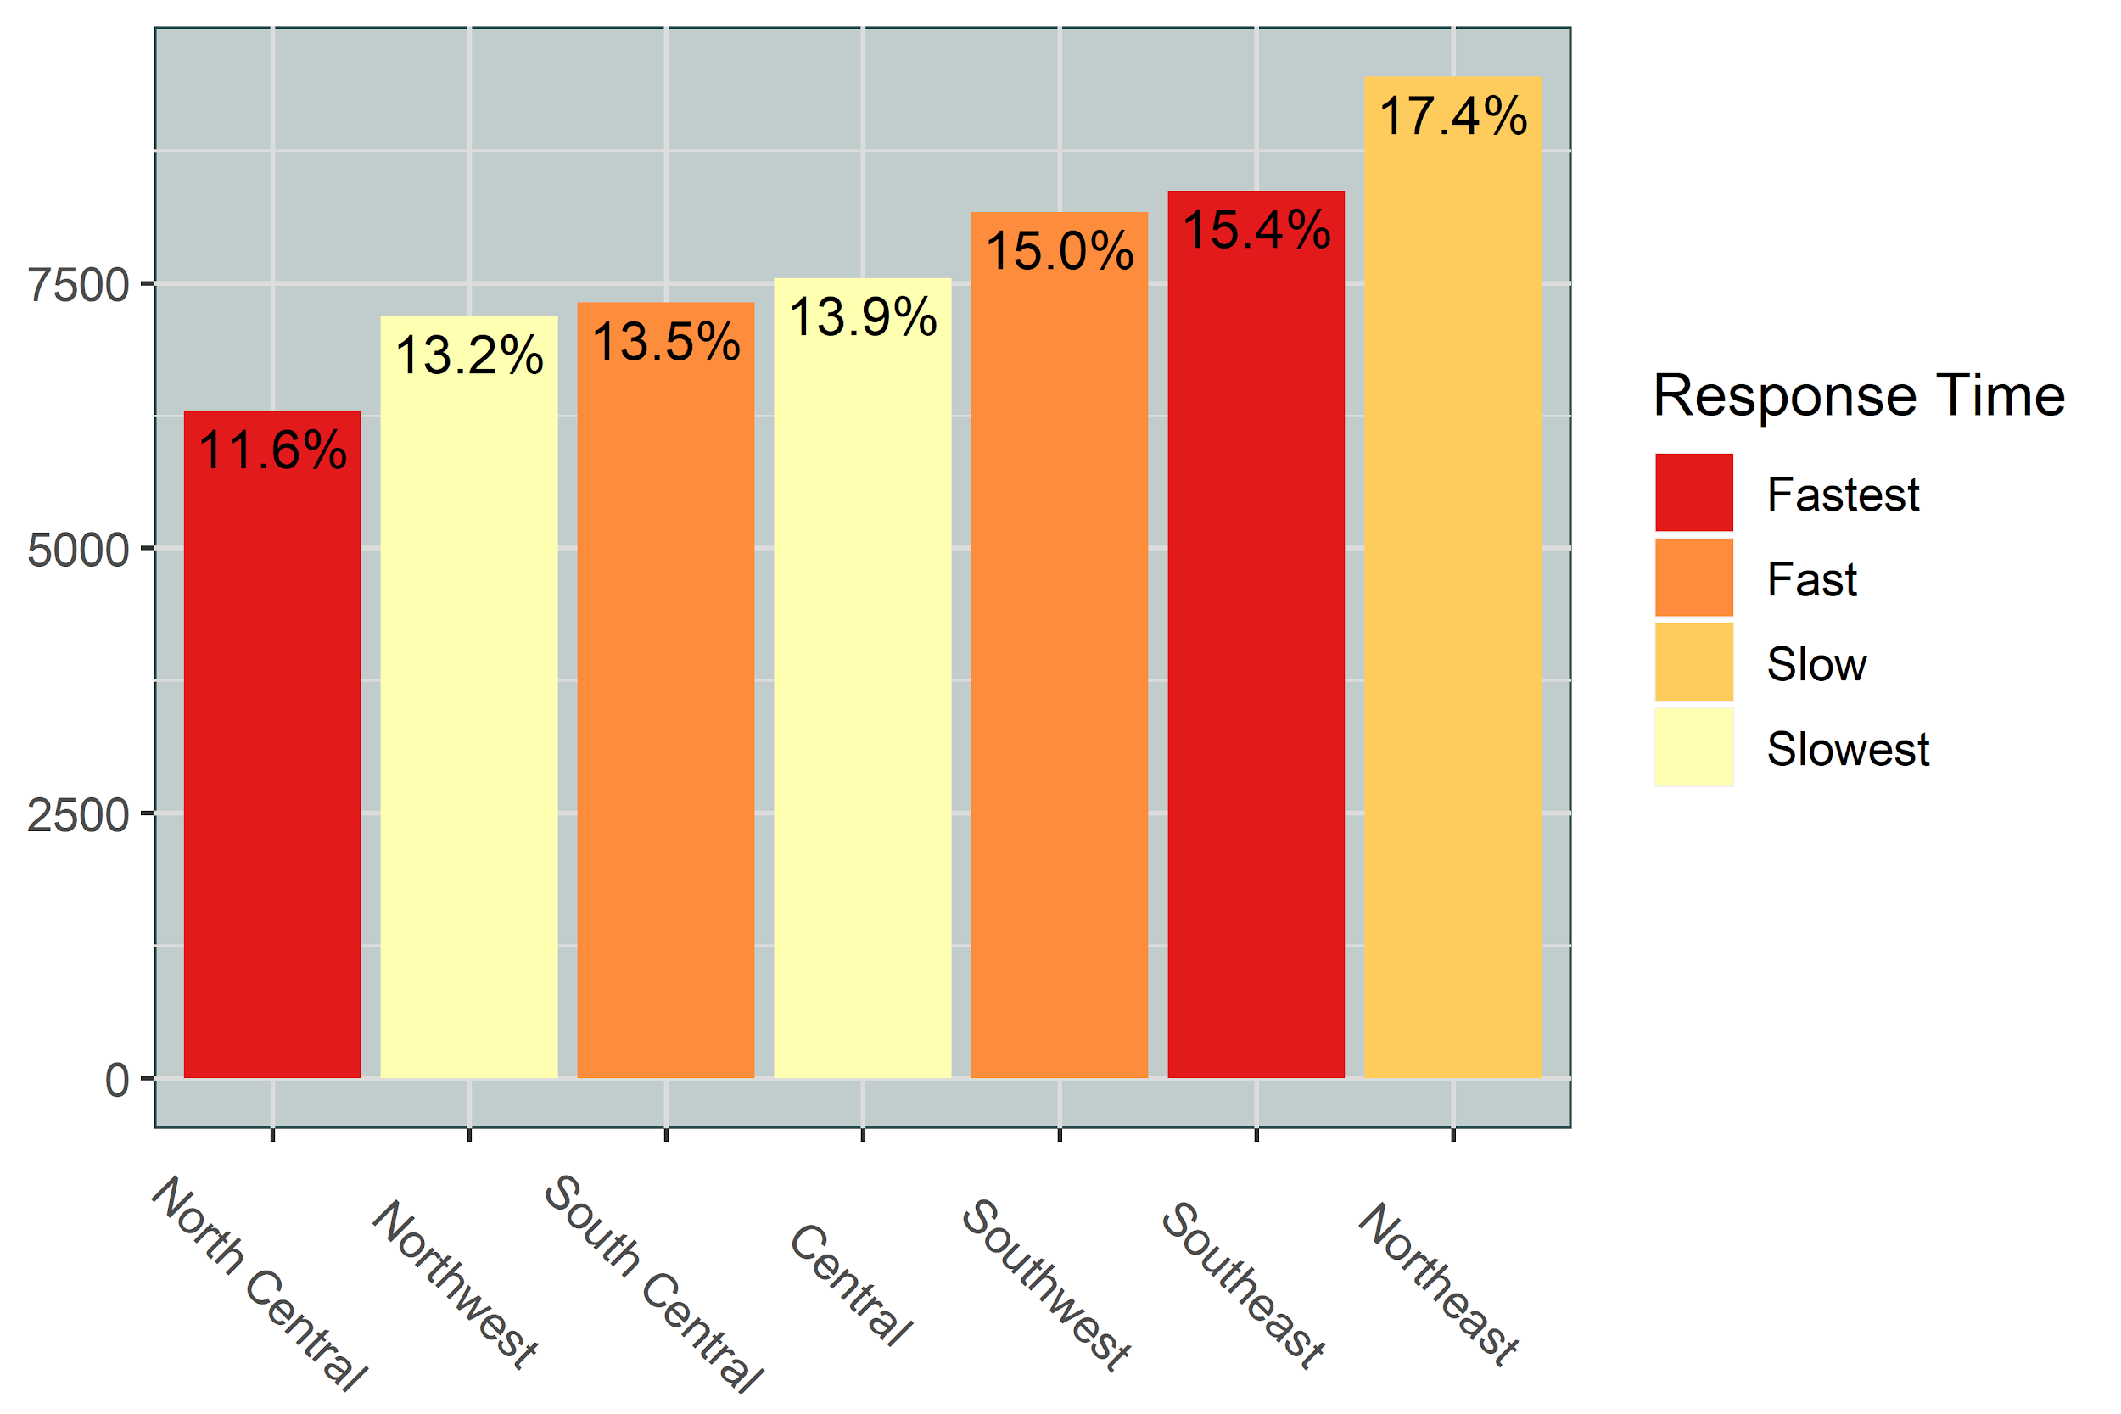
Response Times of Divisions

Slide 28
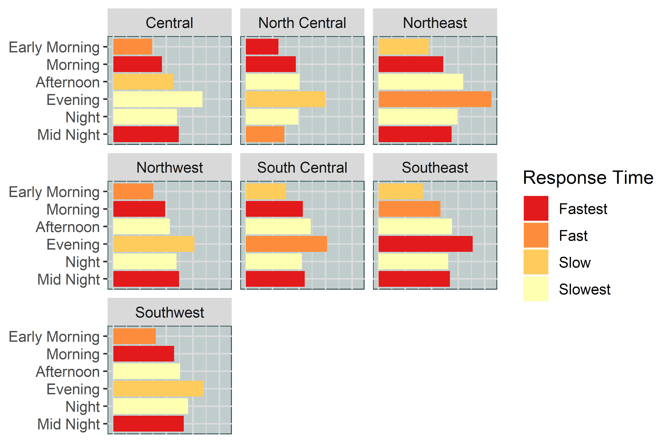
Hourly Response Times of Divisions

Slide 29
Dallas Race Demographics
White
425k
33%
Hispanic or Latino
378k
29%
Black or African American
316k
24%
Other
180k
14%

Slide 30
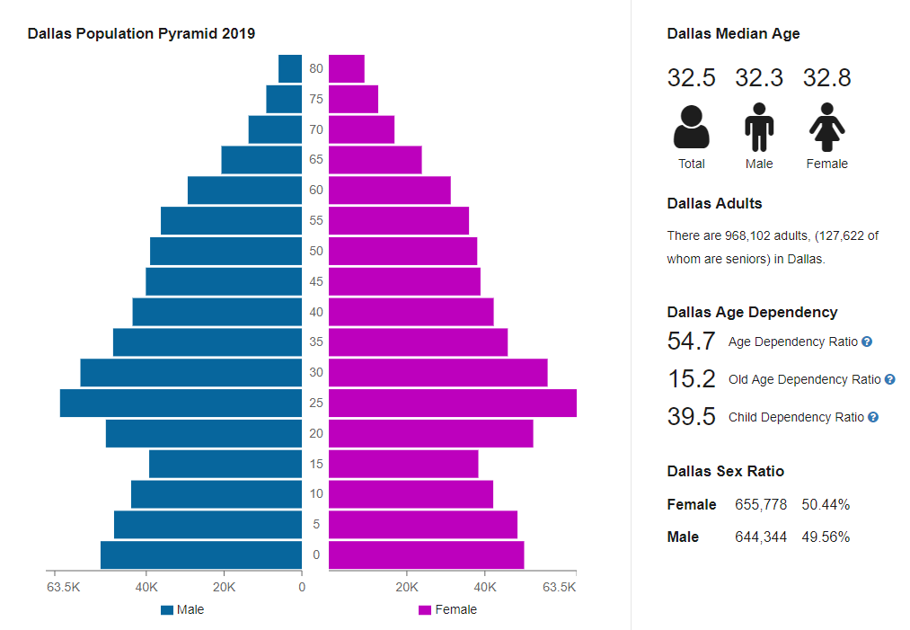
Dallas Age & Gender Demographics
Age Group | Male | Female
Teenager (19 & Younger) | 185k | 190k
Young Adult (20 - 34) | 230k | 220k
Middle Age (35 - 54) | 150k | 155k
Elderly (55 & Older) | 80k | 90k
Total | 645k | 655k

Slide 31
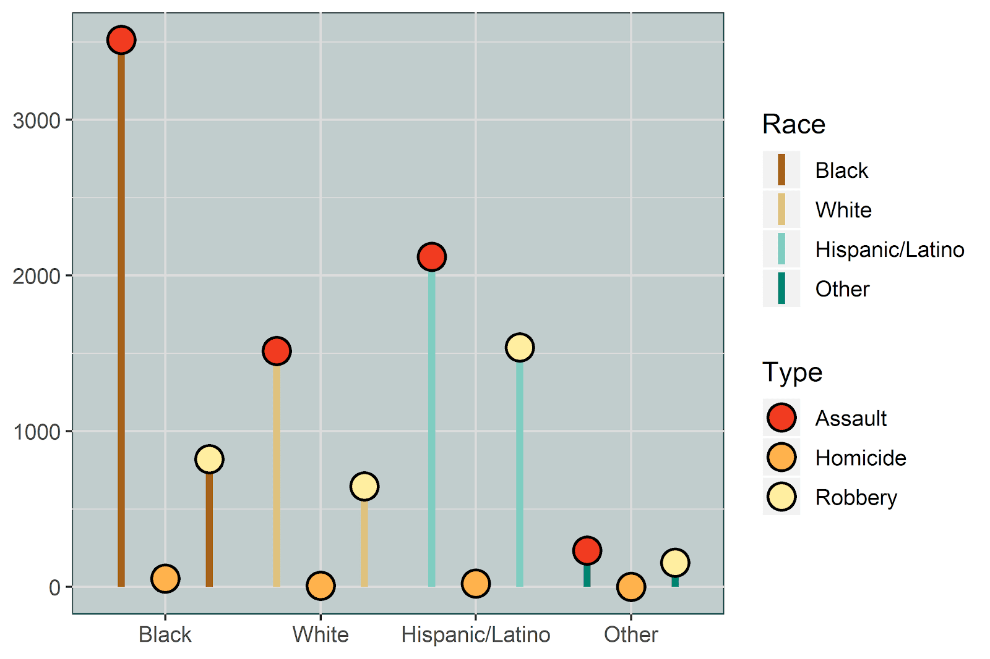
Which race is targeted the most?

Slide 32
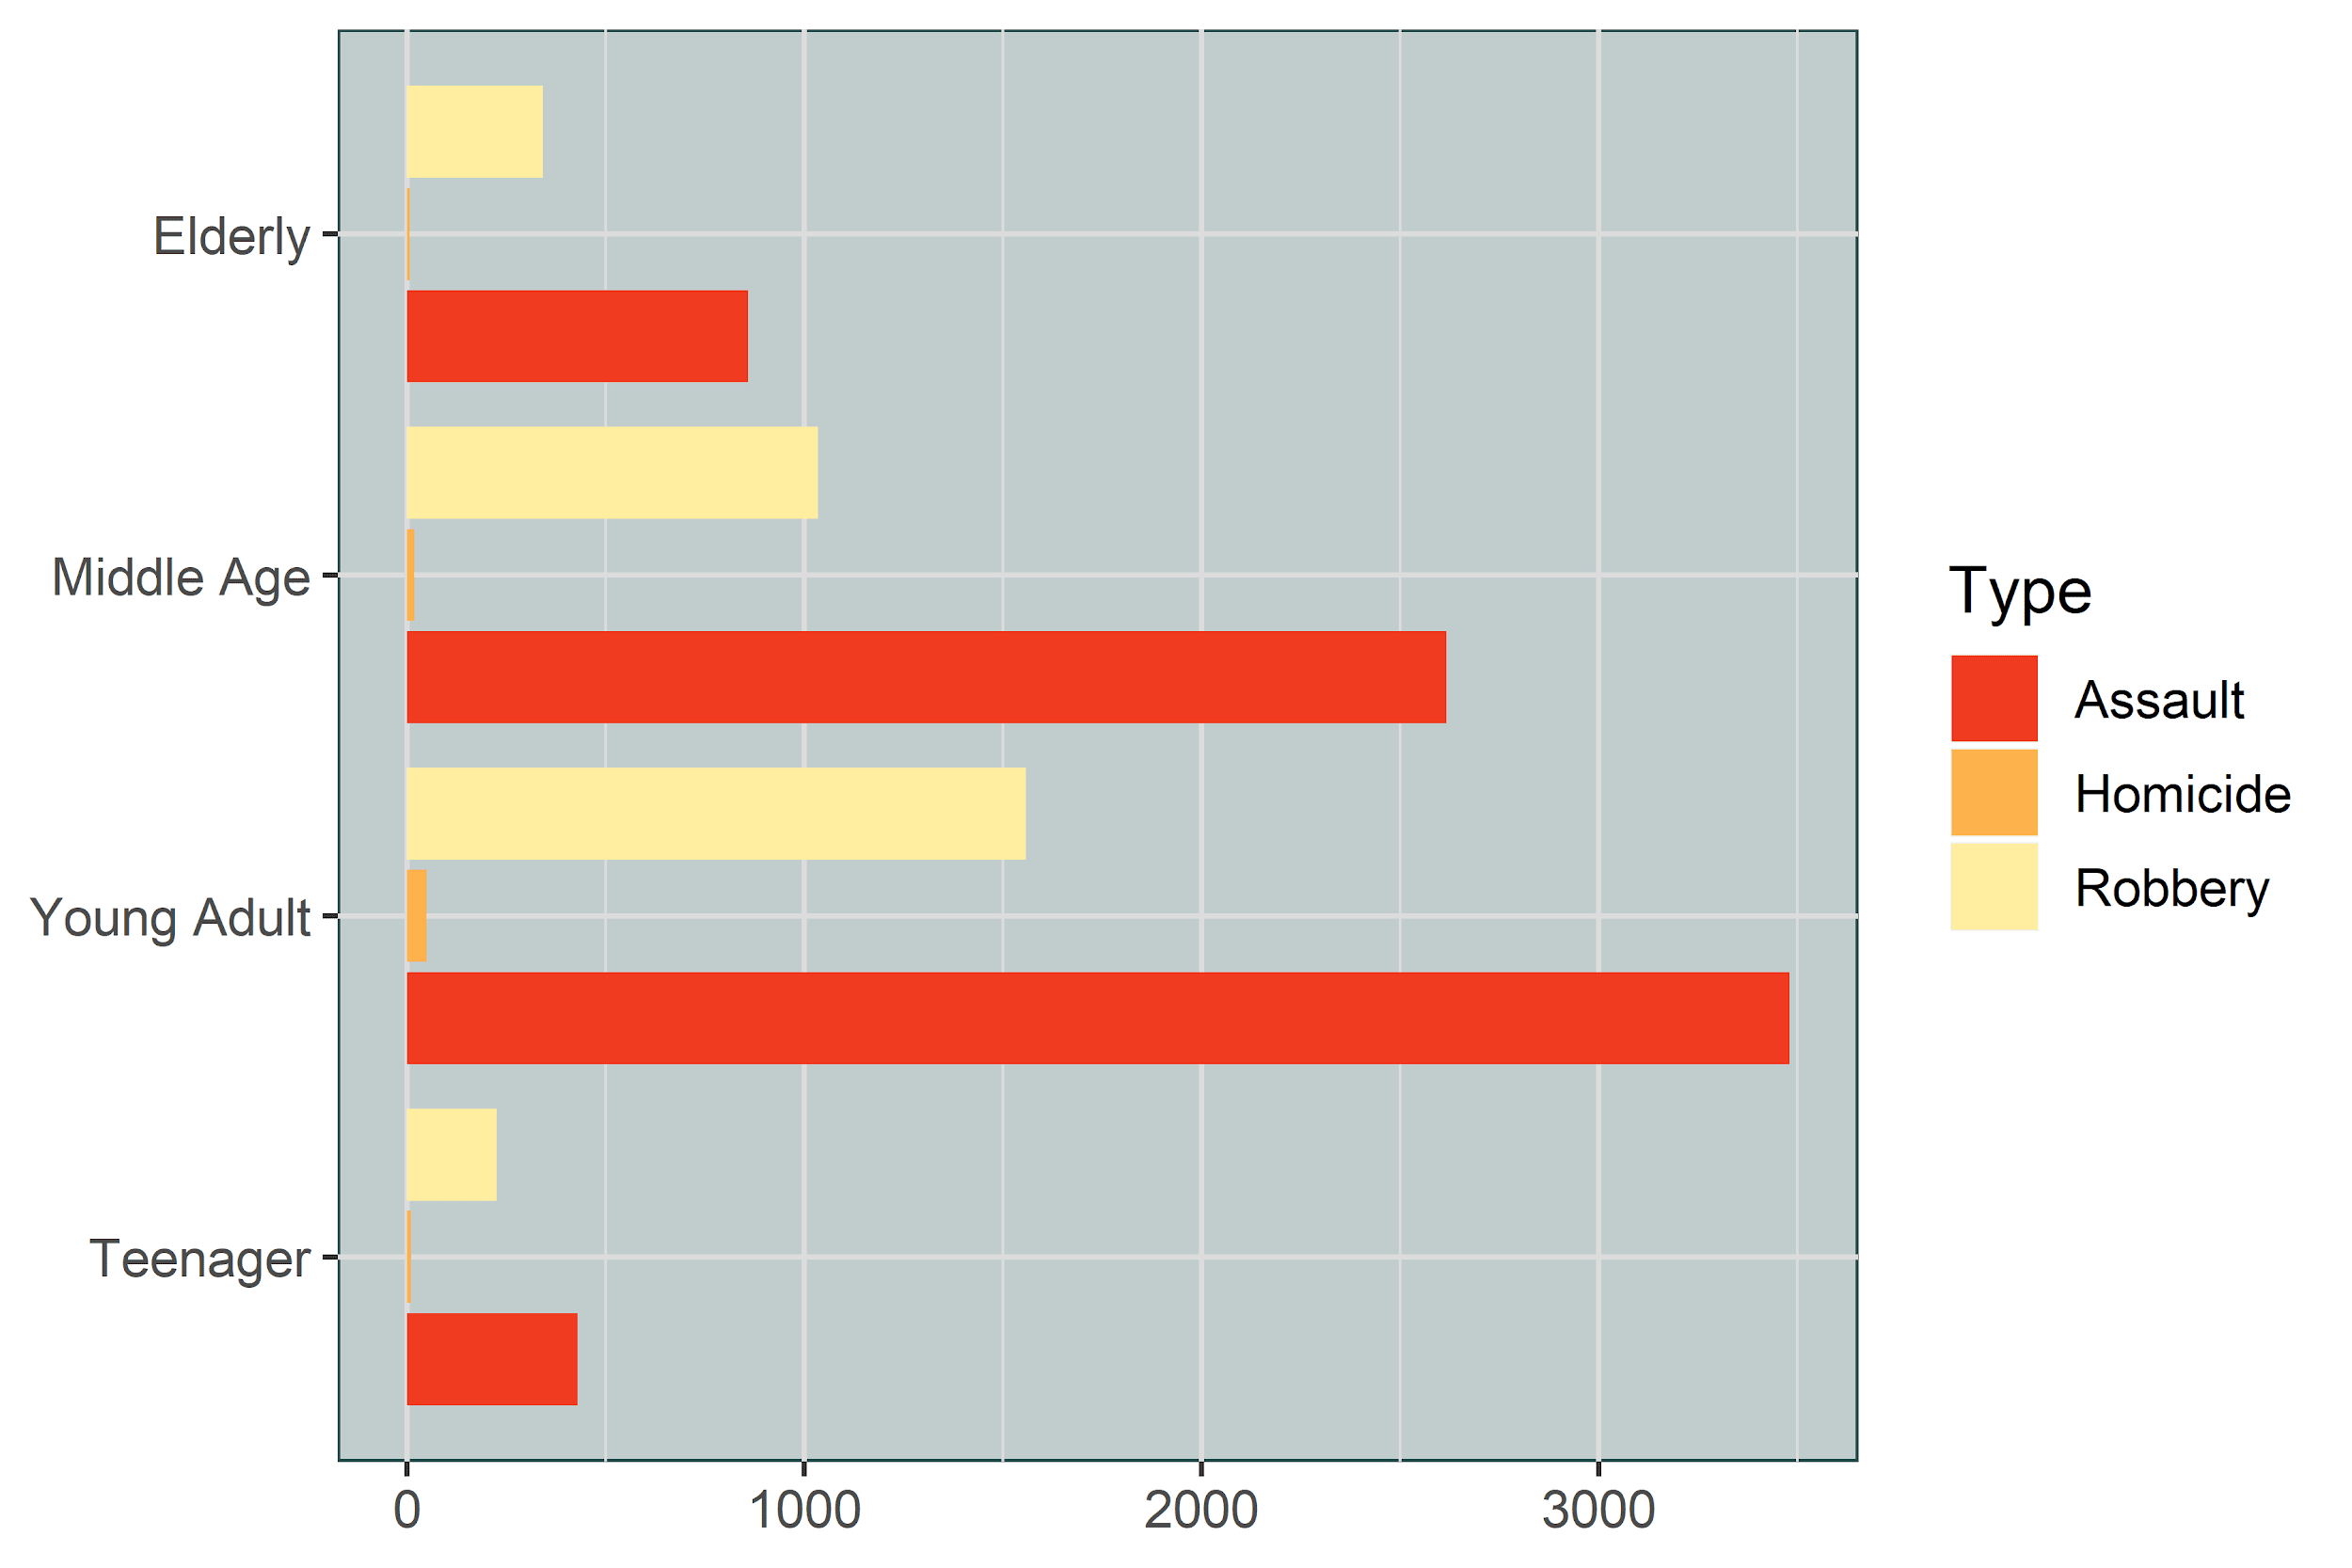
Which age group has most violent crimes?

Slide 33
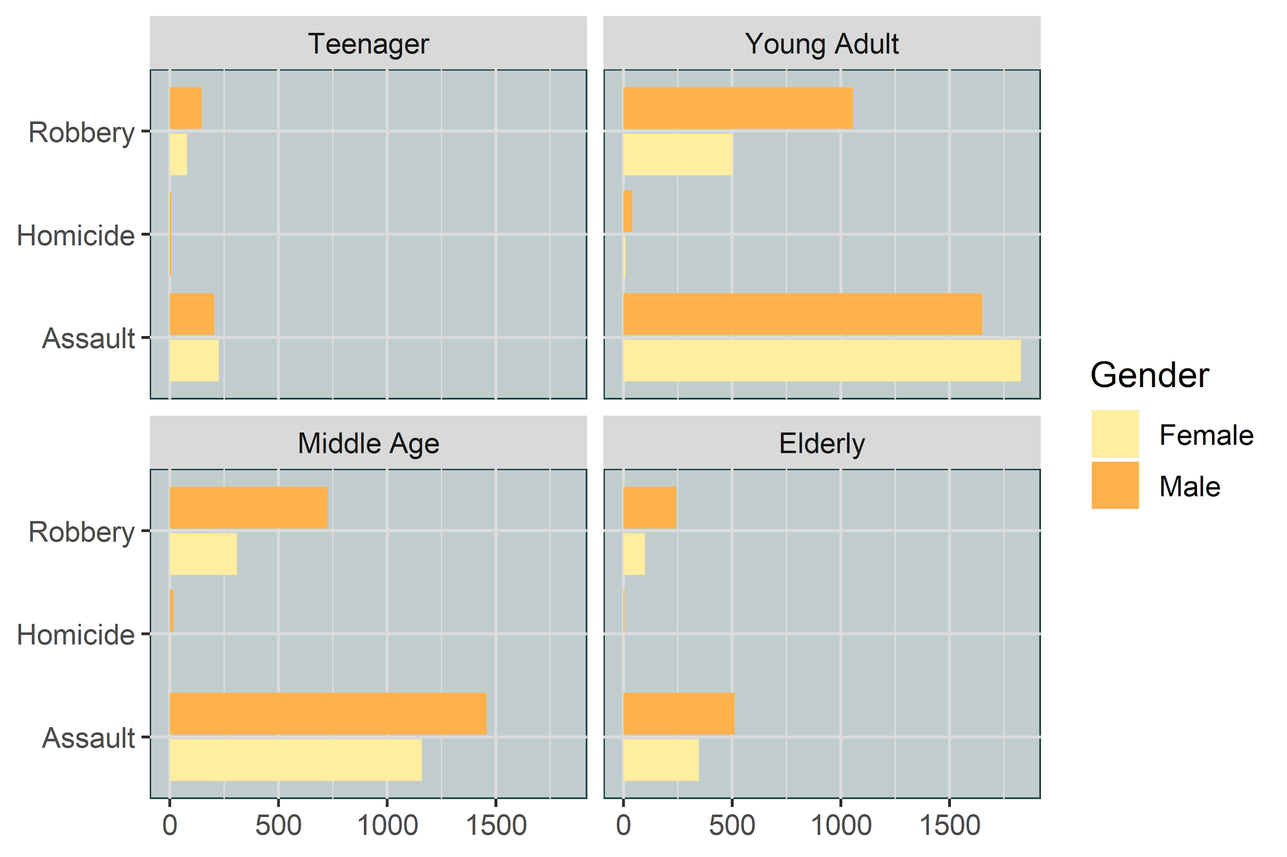
Which age group and gender have most violent crimes against them?

Slide 34
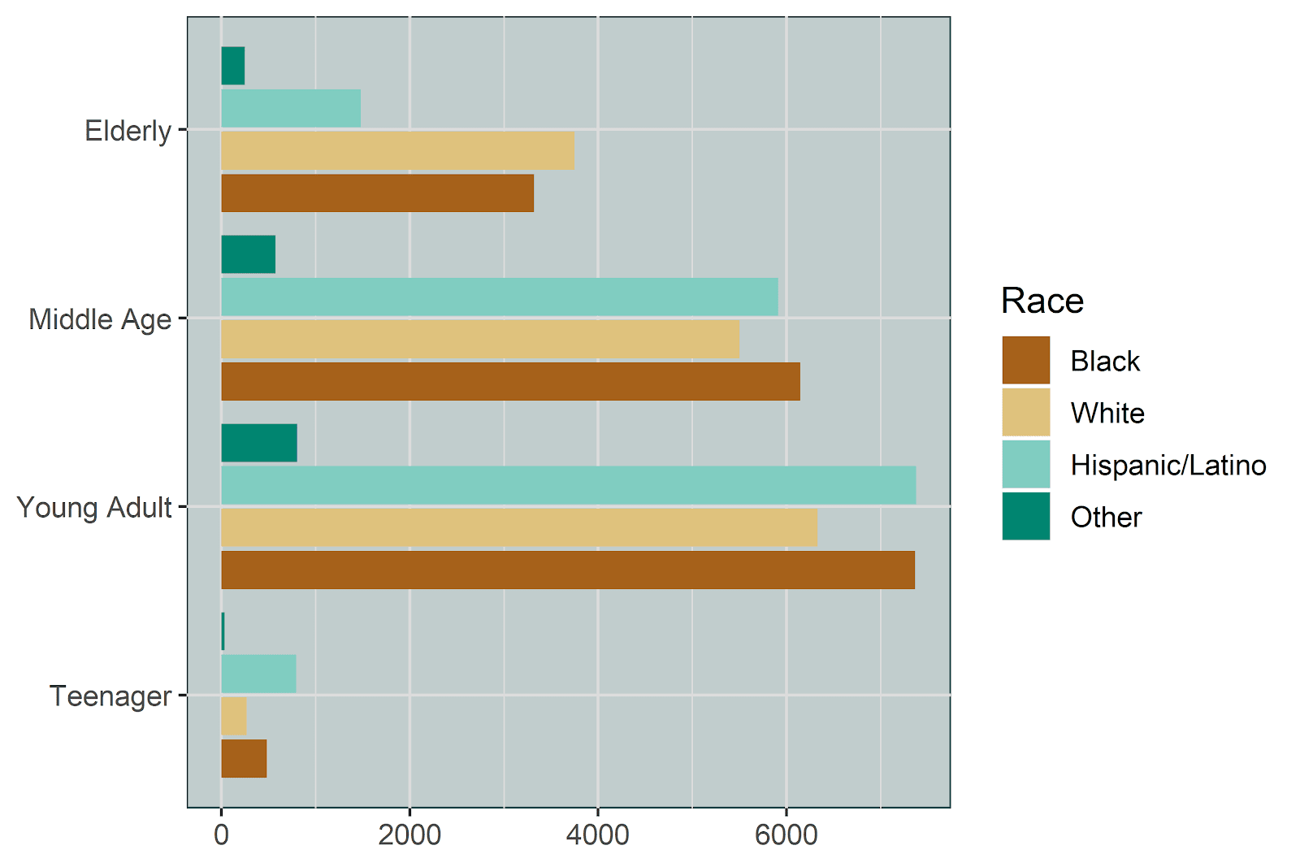
Which age group and race has the most violent crimes against them?

Slide 35

Summary
2018 Dallas crime dataset
Violent crime and crime by Neighborhood
Rates of crime over time
Response times by officers
Demographics of Dallas and victims

Slide 36
Conclusion - Victim Profile
Age Group | Young Adult (Age 20-35)
Gender | Male
Race | Black
Division | Southeast
Day of the week | Saturday - Sunday
Month | July - September

Slide 37
Fastest Division Served
Division | North Central and Southeast
Day of the week | Saturday - Sunday
Month | June - August
Safest Division Served
Division | North Central
Day of the week | Tuesday - Wednesday
Month | January - April

Slide 38

Conclusion
Address officer location to troubled areas
Staffing levels at times when crime and violent crime is at its highest
Community outreach to neighborhoods most crime occurs
Relocating to Dallas? Consider the victim profile and division profile

Slide 39
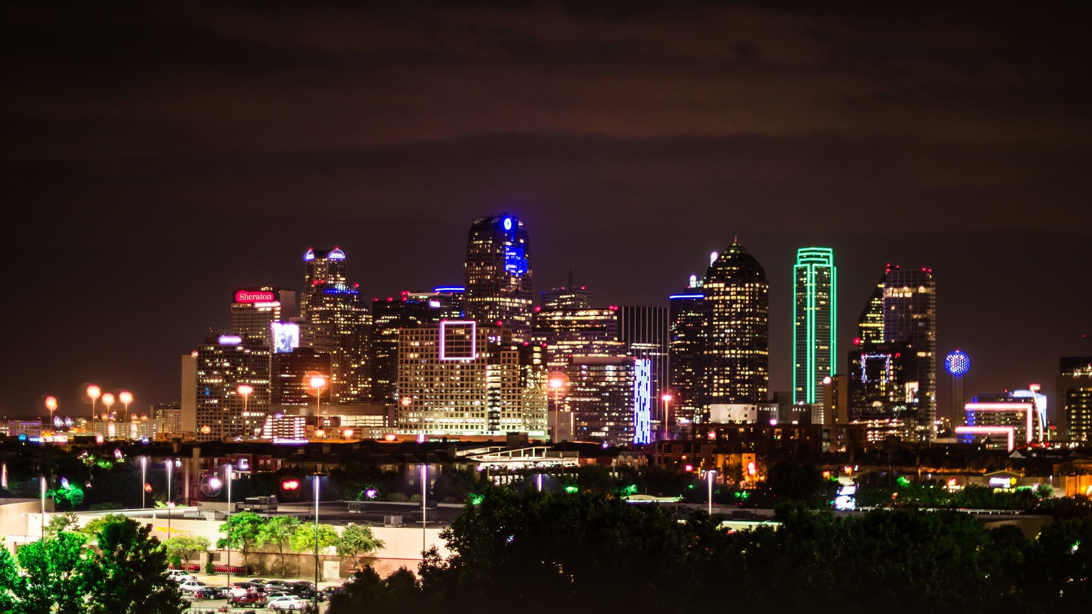
THANK YOU

